Slide 1

M&A
VALUE · RISK · PMI
COURSE SLIDES · WSQ
Strategic Mergers and Acquisitions - Valuation, Risk, and Integration
WSQ Course Code: TGS-2026061581
Conducted by Tertiary Infotech Academy Pte Ltd · UEN 201200696W
Version v2.0 · 13 August 2026
© 2026 Tertiary Infotech Academy Pte Ltd. All rights reserved. · www.tertiarycourses.com.sg

Slide 2
00
COURSE ADMINISTRATION
Welcome, Outcomes and Assessment
Strategic Mergers and Acquisitions · TGS-2026061581
© 2026 Tertiary Infotech Academy Pte Ltd
1

Slide 3
TRAQOM · SSG DIGITAL ATTENDANCE
Digital Attendance (Mandatory)
AM, PM and Assessment
Complete every SSG digital-attendance event shown by the trainer.
Scan the QR code
Use the mobile camera and submit the generated attendance form.
1
2
Verify submission
Tell the trainer immediately if the confirmation does not appear.
Funding condition
At least 75% attendance and a Competent result are required.
3
4
Strategic Mergers and Acquisitions · TGS-2026061581
© 2026 Tertiary Infotech Academy Pte Ltd
2

Slide 4
YOUR TRAINER · GENERAL
About the Trainer
NAME
____________________________________________
?
TITLE / DESIGNATION
____________________________________________
QUALIFICATIONS
____________________________________________
Your Trainer
AREAS OF EXPERTISE
____________________________________________
General Trainer template — to be completed by the trainer
TRAINING & INDUSTRY EXPERIENCE
____________________________________________
CONTACT
____________________________________________
Strategic Mergers and Acquisitions · TGS-2026061581
© 2026 Tertiary Infotech Academy Pte Ltd
3

Slide 5
YOUR TRAINER
About the Trainer
ROLE
Principal Trainer and course facilitator
AA
SPECIALISMS
Business, technology and applied decision-making
Dr. Alfred Ang
DELIVERY
WSQ professional development and workplace application
Principal Trainer · Tertiary Infotech Academy Pte Ltd
CONTACT
enquiry@tertiaryinfotech.com
Strategic Mergers and Acquisitions · TGS-2026061581
© 2026 Tertiary Infotech Academy Pte Ltd
4

Slide 6
INTRODUCTION
Let's Know Each Other
Role
Your organisation, function and decision responsibilities.
M&A exposure
A deal, diligence, valuation or integration experience.
1
2
Learning goal
The decision or capability you want to strengthen.
Case lens
One stakeholder whose perspective you will represent today.
3
4
Strategic Mergers and Acquisitions · TGS-2026061581
© 2026 Tertiary Infotech Academy Pte Ltd
5

Slide 7
HOUSEKEEPING
Ground Rules
Participate
Challenge assumptions and contribute evidence.
Respect
Disagree with ideas, not people.
1
2
Confidentiality
Use public or course data only; do not disclose live deal information.
Devices
Silent mode; step out quietly if needed.
3
4
Time
Return from breaks promptly.
Attendance
Maintain the required SSG attendance record.
5
6
Strategic Mergers and Acquisitions · TGS-2026061581
© 2026 Tertiary Infotech Academy Pte Ltd
6

Slide 8
LESSON PLAN
Course Outline — 2 Days
Day 1
Day 2
• Day 1 — Structure, Value and Forecast
– Topic 1: deal instruments, valuation and scale
– Activities 1–2: thesis/structure and valuation
– Topic 2: forecast, synergies, statements and tax
– Activities 3–4: synergy model and board challenge
• Day 2 — Risk, Intelligence and Integration
– Topic 3: screening, diligence, risk and BI
– Activities 5–6: diligence and risk intelligence
– Topic 4: governance, people and integration
– Activities 7–8; WA 4–5pm; CS 5–6pm
Strategic Mergers and Acquisitions · TGS-2026061581
© 2026 Tertiary Infotech Academy Pte Ltd
7

Slide 9
WHAT YOU WILL ACHIEVE
Learning Outcomes
LO1
Apply financial instruments and valuation methods to structure mergers and acquisitions that optimise organisational benefit and shareholder value.
LO2
Evaluate the business, financial and tax impact of potential M&A deals using industry data and forecasting techniques.
1
2
LO3
Identify, assess and manage M&A risks across the full transaction lifecycle from target selection to post-deal integration.
LO4
Collaborate with stakeholders to develop and implement M&A plans while ensuring governance, synergy realisation and strategic alignment.
3
4
Strategic Mergers and Acquisitions · TGS-2026061581
© 2026 Tertiary Infotech Academy Pte Ltd
8

Slide 10
TSC ALIGNMENT
Skills Framework Alignment
WST-CFI-5003-1.1-1
Knowledge K1–K5
Abilities A1–A6
• Mergers and Acquisition
• One 5-level Technical Skill and Competency
• Instruments · forecasts · valuation · industry · financial/tax impact
• Value · controls · integration · risk · intelligence · opportunity evaluation
Strategic Mergers and Acquisitions · TGS-2026061581
© 2026 Tertiary Infotech Academy Pte Ltd
9

Slide 11
BEFORE ASSESSMENT
Briefing for Assessment
Individual
No discussion, photography or recording.
Open book
Use slides, Learner Guide and approved course materials only.
1
2
Submission
Answer in your own words and upload the completed document to the LMS.
Conduct
Phones and other materials under the table; follow assessor instructions.
3
4
Outcome
Competent or Not Yet Competent; reassessment and appeal are available.
Sign-off
Complete digital attendance and sign the Assessment Summary Record.
5
6
Strategic Mergers and Acquisitions · TGS-2026061581
© 2026 Tertiary Infotech Academy Pte Ltd
10

Slide 12
FINAL ASSESSMENT
Assessment and Funding
WA-SAQ · 1 hour
Case Study · 1 hour
Competency
• 4 open-ended questions
• Covers K1–K5
• Open book
• 3 integrated tasks
• Covers A1–A6
• Open book
• Satisfactory evidence
• At least 75% attendance
• Appeal process available
Strategic Mergers and Acquisitions · TGS-2026061581
© 2026 Tertiary Infotech Academy Pte Ltd
11

Slide 13
ON ASSESSMENT DAY
Assessment Flow
1
2
3
4
5
▶
▶
▶
▶
TRAQOM / SSG attendance
Assessment digital attendance
Sit WA then Case Study
Submit answers on the LMS
Sign the Assessment Summary Record
Strategic Mergers and Acquisitions · TGS-2026061581
© 2026 Tertiary Infotech Academy Pte Ltd
12

Slide 14
HANDS-ON MATERIALS
Access the Course Activities
https://github.com/tertiarycourses/TGS-2026061581-Strategic-Mergers-and-Acquisitions-Valuation-Risk-and-Integration
Clone
Download ZIP
One folder each
git clone the repository, then open the activities folder.
Use GitHub Code → Download ZIP when Git is unavailable.
Every activity includes scenario, questions, steps and acceptance criteria.
Strategic Mergers and Acquisitions · TGS-2026061581
© 2026 Tertiary Infotech Academy Pte Ltd
13

Slide 15
COURSEWARE AND ASSESSMENT
Download Course Material
https://lms-tms.tertiaryinfotech.com/
1 · Sign in
2 · Open course
3 · Download
Open the LMS with your registered email and password or OTP.
Select this TGS course from your enrolled courses.
Download slides and the Learner Guide; assessments are completed on the LMS.
Strategic Mergers and Acquisitions · TGS-2026061581
© 2026 Tertiary Infotech Academy Pte Ltd
14

Slide 16
C
CORE MODEL
One Deal · One Evidence Chain
Strategic Mergers and Acquisitions · TGS-2026061581
© 2026 Tertiary Infotech Academy Pte Ltd
15

Slide 17
END-TO-END VIEW
The decision chain
1
2
3
4
5
▶
▶
▶
▶
Strategic thesis
Valuation and structure
Diligence and risk
Approval and close
Integration and value
Strategic Mergers and Acquisitions · TGS-2026061581
© 2026 Tertiary Infotech Academy Pte Ltd
16

Slide 18
DO NOT CONFUSE FACT WITH ASSUMPTION
Evidence hierarchy
Verified public fact
Published or regulatory information with source and date.
Management assertion
A claim to be tested against documents and operating evidence.
1
2
Training assumption
A simulated input used only for learning and clearly labelled.
Independent evidence
Third-party, customer, market, legal or specialist verification.
3
4
Strategic Mergers and Acquisitions · TGS-2026061581
© 2026 Tertiary Infotech Academy Pte Ltd
17

Slide 19
COURSE CASE
A strong M&A recommendation links thesis → evidence → value → risk → owner.
If one link is missing, the decision is not ready.
Strategic Mergers and Acquisitions · TGS-2026061581
© 2026 Tertiary Infotech Academy Pte Ltd
18

Slide 20
01
TOPIC 01 · K1 · K3 · A1
Deal Structuring and Valuation Principles
Financial instruments · valuation · shareholder value · economies of scale
Strategic Mergers and Acquisitions · TGS-2026061581
© 2026 Tertiary Infotech Academy Pte Ltd
19

Slide 21
TSC WST-CFI-5003-1.1-1
Key Concepts — Deal Structuring and Valuation Principles
Deal thesis
A transaction starts with a testable strategic rationale, not a price.
Structure
Consideration, financing, control and risk allocation work together.
1
2
Value
Triangulate methods; reconcile enterprise value to equity value.
Discipline
Normalise earnings, challenge synergies and preserve downside protection.
3
4
Strategic Mergers and Acquisitions · TGS-2026061581
© 2026 Tertiary Infotech Academy Pte Ltd
20

Slide 22
TOPIC 01 · K1 · K3 · A1
Merger, acquisition or another route?
Merger
Acquisition
Alternatives
• Businesses combine under shared control; governance must be redesigned.
• A buyer obtains control through shares, assets or a negotiated business transfer.
• Joint venture, alliance, licensing or organic build may deliver the objective with less integration risk.
Strategic Mergers and Acquisitions · TGS-2026061581
© 2026 Tertiary Infotech Academy Pte Ltd
21

Slide 23
TOPIC 01 · K1 · K3 · A1
The M&A value chain
1
2
3
4
5
▶
▶
▶
▶
Strategy and target thesis
Screen and approach
Value and structure
Diligence and negotiate
Close and integrate
Strategic Mergers and Acquisitions · TGS-2026061581
© 2026 Tertiary Infotech Academy Pte Ltd
22

Slide 24
TOPIC 01 · K1 · K3 · A1
Why organisations pursue M&A
Scale
Lower unit costs through procurement, systems and shared services.
Scope
Add capabilities, products, client segments or geographies.
1
2
Speed
Buy proven talent, technology, licences or distribution rather than build.
Resilience
Diversify revenue, reduce concentration or reinforce a strategic position.
3
4
Strategic Mergers and Acquisitions · TGS-2026061581
© 2026 Tertiary Infotech Academy Pte Ltd
23

Slide 25
TOPIC 01 · K1 · K3 · A1
Consideration instruments
Cash
Price certainty for the seller; liquidity and leverage pressure for the buyer.
Shares
Shares risk and upside; introduces dilution, valuation and governance questions.
1
2
Earn-out
Defers value until agreed performance is achieved; definitions must be precise.
Rollover equity
Keeps sellers invested in NewCo and aligns them with future value creation.
3
4
Strategic Mergers and Acquisitions · TGS-2026061581
© 2026 Tertiary Infotech Academy Pte Ltd
24

Slide 26
TOPIC 01 · K1 · K3 · A1
Financing and risk-allocation instruments
Senior debt
Lower cost and tax-deductible interest, but covenants constrain flexibility.
Seller note
Bridges a funding or valuation gap; seller retains credit exposure.
1
2
Preferred / convertible
Blends downside protection with participation in upside.
Escrow / holdback
Secures claims for warranties, indemnities or post-close adjustments.
3
4
Strategic Mergers and Acquisitions · TGS-2026061581
© 2026 Tertiary Infotech Academy Pte Ltd
25

Slide 27
TOPIC 01 · K1 · K3 · A1
Share purchase versus asset purchase
Perspective A
Perspective B
• Buyer acquires the legal entity and its contracts, assets and liabilities.
• Continuity may be simpler, but unknown liabilities can follow the entity.
• Diligence, warranties and indemnities are critical.
• Buyer selects assets and assumed liabilities subject to transfer rules.
• May permit tax basis step-up, but consents and novation can be complex.
• Employee, licence and indirect-tax effects need local advice.
Strategic Mergers and Acquisitions · TGS-2026061581
© 2026 Tertiary Infotech Academy Pte Ltd
26

Slide 28
TOPIC 01 · K1 · K3 · A1
Price is what is paid; value is what the buyer can defend.
A valuation range must show assumptions, uncertainty and the bridge to the negotiated consideration.
Strategic Mergers and Acquisitions · TGS-2026061581
© 2026 Tertiary Infotech Academy Pte Ltd
27

Slide 29
TOPIC 01 · K1 · K3 · A1
Valuation triangulation
1
2
3
4
5
▶
▶
▶
▶
Normalise earnings
Build standalone forecast
Value with DCF
Benchmark comps and precedents
Reconcile to a range
Strategic Mergers and Acquisitions · TGS-2026061581
© 2026 Tertiary Infotech Academy Pte Ltd
28

Slide 30
TOPIC 01 · K1 · K3 · A1
Enterprise value and equity value
Enterprise value
Value of operations available to debt and equity capital providers.
Equity bridge
EV minus debt-like items plus cash and agreed adjustments.
1
2
Working capital
Completion accounts or a locked-box protects the normal operating level.
Per-share value
Equity value divided by diluted shares, after options and other claims.
3
4
Strategic Mergers and Acquisitions · TGS-2026061581
© 2026 Tertiary Infotech Academy Pte Ltd
29

Slide 31
TOPIC 01 · K1 · K3 · A1
Income approach: DCF
Perspective A
Perspective B
• Forecast unlevered free cash flow from operating drivers.
• Discount with a rate consistent with risk and cash-flow definition.
• Estimate terminal value without letting it dominate unexplained.
• DCF exposes value drivers and integration assumptions.
• It is sensitive to WACC, terminal growth, margins and reinvestment.
• Use scenarios and sensitivities; avoid false precision.
Strategic Mergers and Acquisitions · TGS-2026061581
© 2026 Tertiary Infotech Academy Pte Ltd
30

Slide 32
TOPIC 01 · K1 · K3 · A1
Market approaches
Perspective A
Perspective B
• Trading comparables apply peer valuation multiples to the target's metric.
• They reflect current market expectations but require genuinely comparable peers.
• Adjust for scale, growth, margins, geography and business mix.
• Precedent transactions reflect control premiums and deal-market conditions.
• They may include strategic synergies not available to every buyer.
• Date, cycle, structure and accounting consistency matter.
Strategic Mergers and Acquisitions · TGS-2026061581
© 2026 Tertiary Infotech Academy Pte Ltd
31

Slide 33
TOPIC 01 · K1 · K3 · A1
Normalising EBITDA and cash flow
Owner items
Replace related-party or owner compensation with market levels.
One-offs
Remove genuinely non-recurring items, with evidence.
1
2
Run-rate
Reflect contracted or implemented changes without double counting.
Cash conversion
Test capex, working capital and tax; EBITDA is not cash flow.
3
4
Strategic Mergers and Acquisitions · TGS-2026061581
© 2026 Tertiary Infotech Academy Pte Ltd
32

Slide 34
TOPIC 01 · K1 · K3 · A1
Valuation risk controls
Sensitivity
Show value over a rational WACC and terminal assumption range.
Scenario
Build base, upside and downside operating cases.
1
2
Cross-check
Compare implied multiples and free-cash-flow yield.
Independent challenge
Separate deal advocacy from valuation review and approval.
3
4
Strategic Mergers and Acquisitions · TGS-2026061581
© 2026 Tertiary Infotech Academy Pte Ltd
33

Slide 35
TOPIC 01 · K1 · K3 · A1
Value-creation levers
Revenue
Cross-sell, price, retention, channel and new capability.
Cost
Procurement, property, technology and shared services.
1
2
Capital
Working capital, capex, tax and portfolio optimisation.
Multiple
Improve recurring revenue, resilience, governance and growth quality.
3
4
Strategic Mergers and Acquisitions · TGS-2026061581
© 2026 Tertiary Infotech Academy Pte Ltd
34

Slide 36
TOPIC 01 · K1 · K3 · A1
Internal economies of scale
Commercial
Operating
Financial
• Shared brand, channels, CRM and client coverage.
• Central procurement, platforms, training and administration.
• Funding access, cash pooling and professionalised controls.
Strategic Mergers and Acquisitions · TGS-2026061581
© 2026 Tertiary Infotech Academy Pte Ltd
35

Slide 37
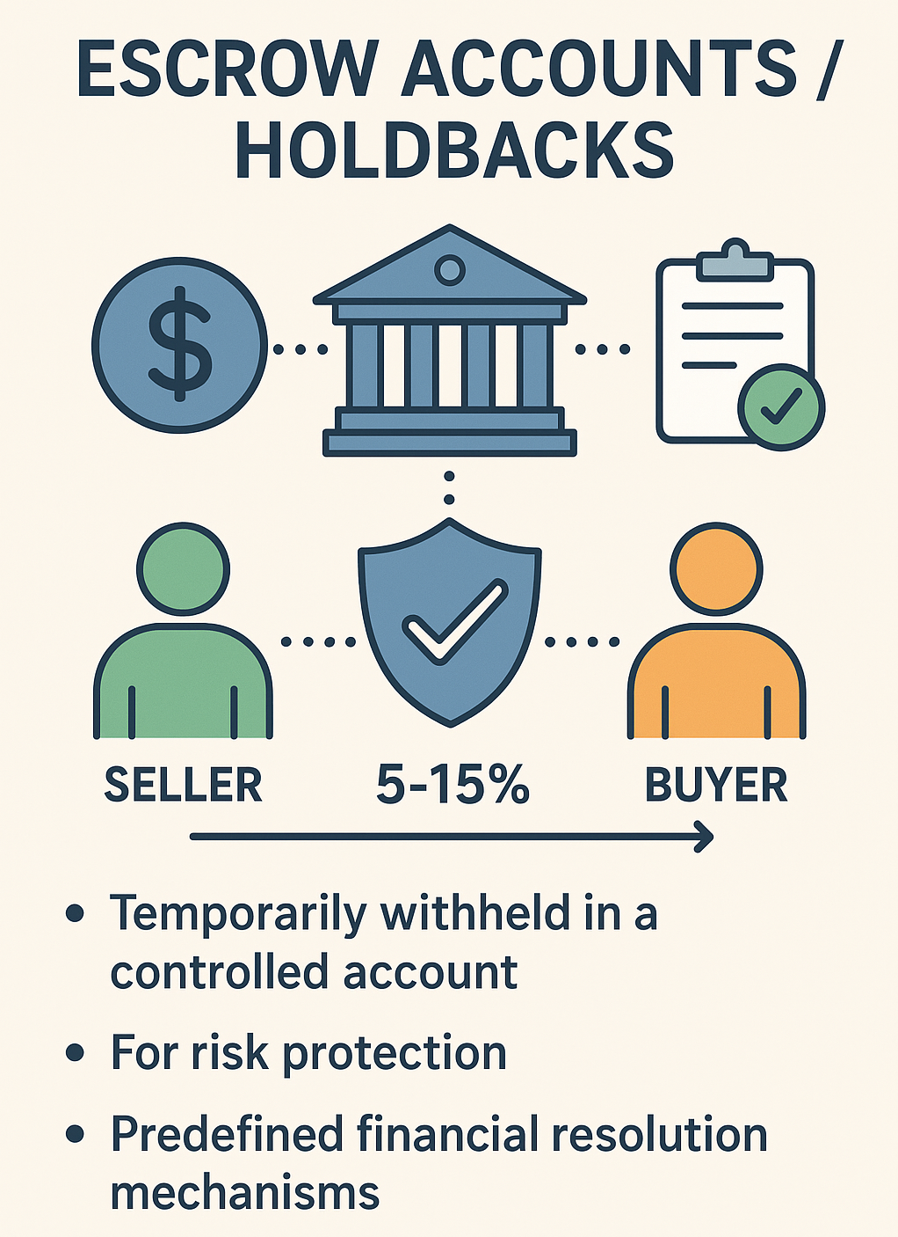
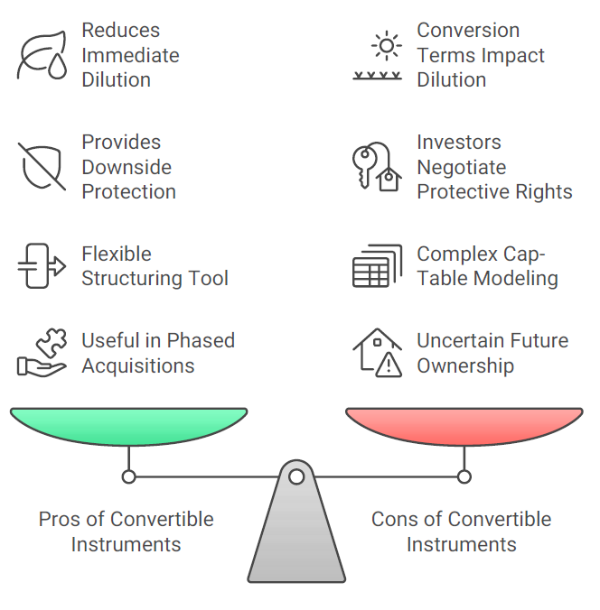
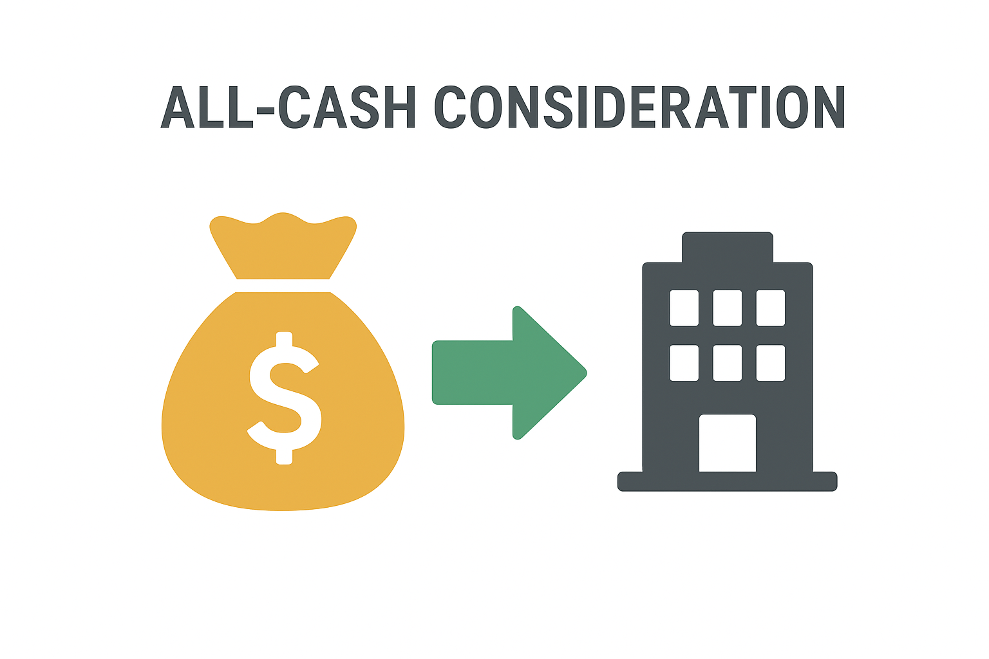
ORIGINAL DECK · VISUAL REFERENCE
How consideration moves
Cash consideration
Escrow / holdback
Convertible instrument
Reused from the supplied original PPT; interpret using the updated v2.0 concepts and evidence.
Strategic Mergers and Acquisitions · TGS-2026061581
© 2026 Tertiary Infotech Academy Pte Ltd
36

Slide 38
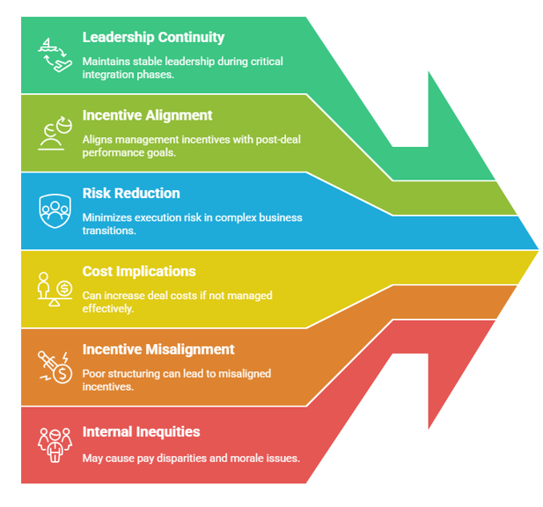
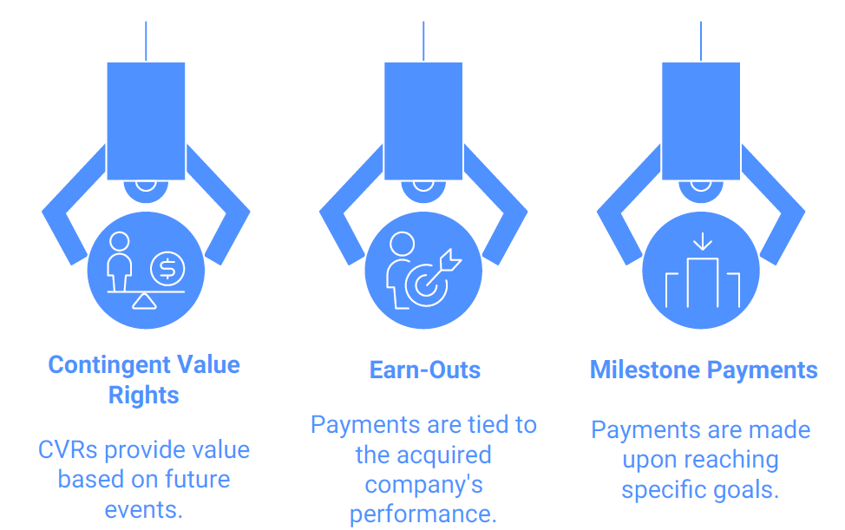
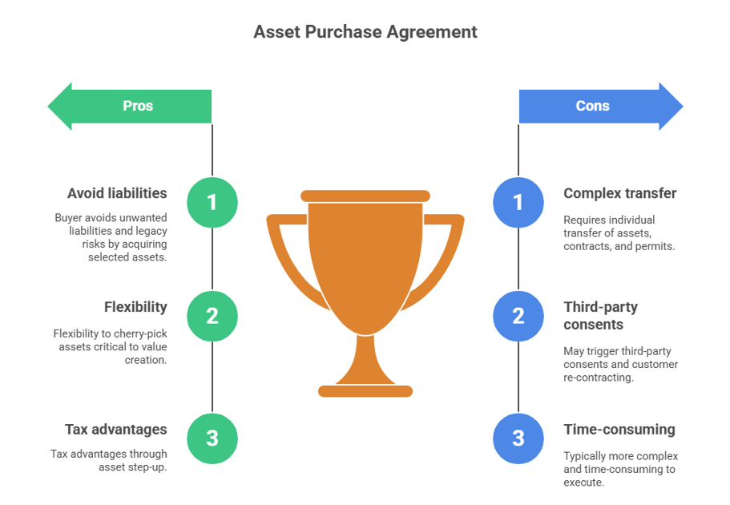
ORIGINAL DECK · VISUAL REFERENCE
How risk is allocated
Contingent consideration
Asset purchase
Retention mechanisms
Reused from the supplied original PPT; interpret using the updated v2.0 concepts and evidence.
Strategic Mergers and Acquisitions · TGS-2026061581
© 2026 Tertiary Infotech Academy Pte Ltd
37

Slide 39
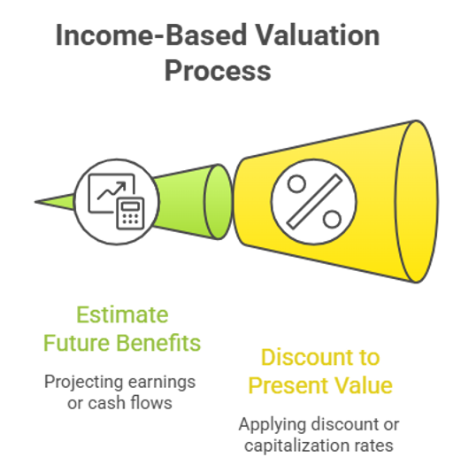
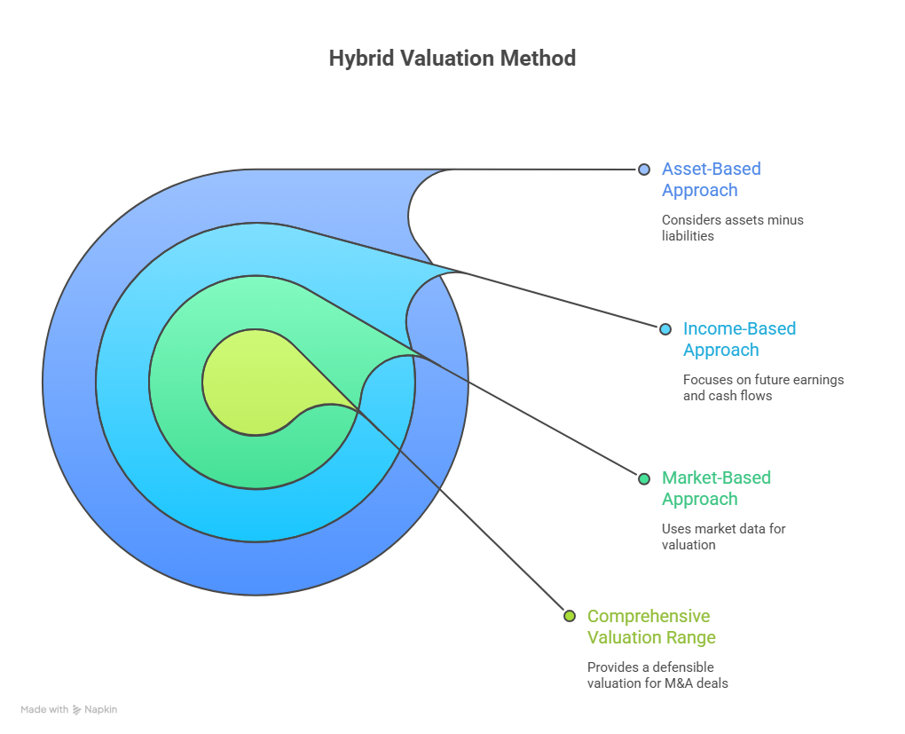
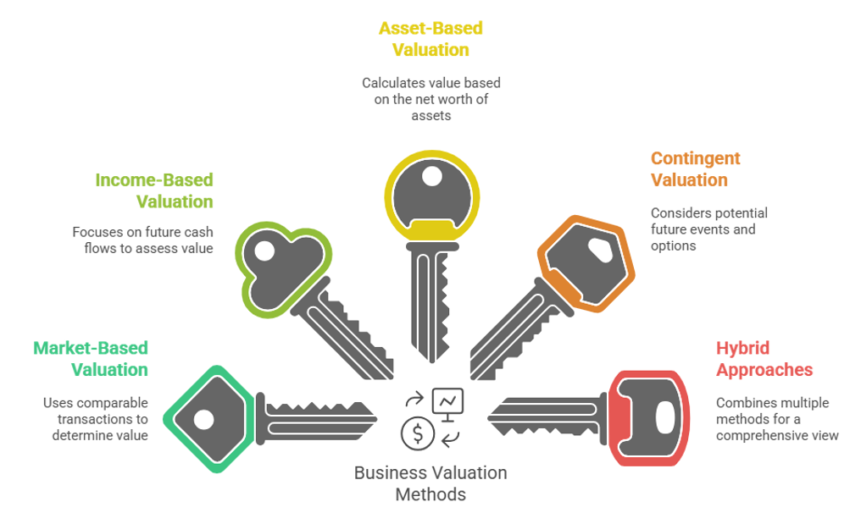
ORIGINAL DECK · VISUAL REFERENCE
How value is triangulated
Valuation families
Income approach
Hybrid triangulation
Reused from the supplied original PPT; interpret using the updated v2.0 concepts and evidence.
Strategic Mergers and Acquisitions · TGS-2026061581
© 2026 Tertiary Infotech Academy Pte Ltd
38

Slide 40
REAL-WORLD CASE
Applied Activities — Deal Structuring and Valuation Principles
Activity 1
Activity 2
Progressive case
• Bonadio–TGA Deal Thesis and Structure Activity
• K1 · A1 · A6
• Bonadio–TGA Valuation Triangulation Activity
• K3 · A1
• Bonadio–TGA announced transaction
• Facts separated from course assumptions
Strategic Mergers and Acquisitions · TGS-2026061581
© 2026 Tertiary Infotech Academy Pte Ltd
39

Slide 41
TOPIC 01 · K1 · A1 · A6
Bonadio–TGA Deal Thesis and Structure Activity
ACTIVITY 1
Use the announced Bonadio–TGA professional-services transaction to build a defensible strategic thesis and term-sheet architecture.
You'll build
A one-page deal thesis, strategic-fit scorecard and proposed consideration/risk-allocation package
Tools / evidence: Public transaction evidence · deal-thesis canvas · structure decision matrix
Strategic Mergers and Acquisitions · TGS-2026061581
© 2026 Tertiary Infotech Academy Pte Ltd
40

Slide 42
ACTIVITY 1 · REAL TRANSACTION
Case Scenario — Reported Facts and Guardrails
Reported / sourced
Training assumptions / limits
• On 6 August 2026, CPA Practice Advisor reported that The Bonadio Group would add T. Gschwender & Associates (TGA), a Syracuse provider of credit-risk management services to financial institutions. The transaction was expected to close on 16 August 2026; financial terms were not disclosed. TGA was to join Bonadio's internal audit business unit within Advisory & Consulting.
• Source: https://www.cpapracticeadvisor.com/2026/08/06/credit-risk-management-firm-joins-the-bonadio-group/188098/
• No purchase price, revenue, EBITDA or ownership terms were reported; do not infer them.
• For comparison only, assume the seller values continuity, client service and continued management participation.
• Treat every proposed instrument as a learner recommendation, not an account of the actual transaction.
Strategic Mergers and Acquisitions · TGS-2026061581
© 2026 Tertiary Infotech Academy Pte Ltd
41

Slide 43
ACTIVITY 1 · DISCUSS AND DECIDE
Activity Questions
Which facts support strategic fit, and which important facts remain unknown?
Would cash, rollover equity, an earn-out, a seller note or a holdback best allocate risk? Why?
1
2
What value could scale create without weakening TGA's specialist edge?
What conditions would make the team pause or walk away?
3
4
Strategic Mergers and Acquisitions · TGS-2026061581
© 2026 Tertiary Infotech Academy Pte Ltd
42

Slide 44
ACTIVITY 1 · ACCEPTANCE TEST
Bonadio–TGA Deal Thesis and Structure Activity
✅ Test it
The page distinguishes facts from assumptions, proposes at least two instruments, links each term to a risk or value driver, and includes an explicit go/conditional/no-go recommendation.
Strategic Mergers and Acquisitions · TGS-2026061581
© 2026 Tertiary Infotech Academy Pte Ltd
43

Slide 45
TOPIC 01 · K3 · A1
Bonadio–TGA Valuation Triangulation Activity
ACTIVITY 2
Build a screening valuation for the real announced transaction using clearly labelled training assumptions because the deal's financial terms were not disclosed.
You'll build
A transparent valuation workbook with DCF, trading-comparable and precedent-transaction cross-checks
Tools / evidence: Enterprise-value bridge · DCF · comparable multiples · sensitivity analysis
Strategic Mergers and Acquisitions · TGS-2026061581
© 2026 Tertiary Infotech Academy Pte Ltd
44

Slide 46
ACTIVITY 2 · REAL TRANSACTION
Case Scenario — Reported Facts and Guardrails
Reported / sourced
Training assumptions / limits
• On 6 August 2026, CPA Practice Advisor reported that The Bonadio Group would add T. Gschwender & Associates (TGA), a Syracuse provider of credit-risk management services to financial institutions. The transaction was expected to close on 16 August 2026; financial terms were not disclosed. TGA was to join Bonadio's internal audit business unit within Advisory & Consulting.
• Source: https://www.cpapracticeadvisor.com/2026/08/06/credit-risk-management-firm-joins-the-bonadio-group/188098/
• Training case only: FY2026 revenue US$8.0m; normalised EBITDA US$2.0m; cash tax 24%; capex US$0.20m; change in NWC US$0.10m.
• Five-year revenue growth: 8%, 7%, 6%, 5%, 4%; EBITDA margin gradually rises from 25% to 27%.
• DCF base: WACC 12%; terminal growth 3%; net debt US$0.50m.
Strategic Mergers and Acquisitions · TGS-2026061581
© 2026 Tertiary Infotech Academy Pte Ltd
45

Slide 47
ACTIVITY 2 · DISCUSS AND DECIDE
Activity Questions
What adjustments are needed to move reported EBITDA to normalised EBITDA?
What value range emerges from DCF and the 7.0x–9.0x multiple cross-check?
1
2
How does enterprise value bridge to equity value?
Which two assumptions drive the widest value change?
3
4
Strategic Mergers and Acquisitions · TGS-2026061581
© 2026 Tertiary Infotech Academy Pte Ltd
46

Slide 48
ACTIVITY 2 · ACCEPTANCE TEST
Bonadio–TGA Valuation Triangulation Activity
✅ Test it
The model is formula-driven, shows sources/assumptions, has a working sensitivity table and reconciles DCF with the multiple range without claiming undisclosed deal facts.
Strategic Mergers and Acquisitions · TGS-2026061581
© 2026 Tertiary Infotech Academy Pte Ltd
47

Slide 49
TOPIC RECAP
Recap — Deal Structuring and Valuation Principles
Bonadio–TGA Deal Thesis and Structure Activity
Apply financial instruments to shape a deal structure (K1, A1, A6)
Bonadio–TGA Valuation Triangulation Activity
Apply business valuation concepts and reconcile a valuation range (K3, A1)
1
2
Decision habit
Separate facts, assumptions and unresolved evidence.
Transfer
Carry valuation and diligence commitments into integration ownership.
3
4
Strategic Mergers and Acquisitions · TGS-2026061581
© 2026 Tertiary Infotech Academy Pte Ltd
48

Slide 50
Lunch Break
60 minutes

Slide 51
02
TOPIC 02 · K2 · K5 · A1 · A2
Forecasting, Financial and Tax Implications
Business impact · synergies · pro forma statements · tax
Strategic Mergers and Acquisitions · TGS-2026061581
© 2026 Tertiary Infotech Academy Pte Ltd
50

Slide 52
TSC WST-CFI-5003-1.1-1
Key Concepts — Forecasting, Financial and Tax Implications
Standalone first
Forecast the target before adding buyer-specific synergies.
Timing matters
Separate run-rate benefit, ramp-up and one-off cost to achieve.
1
2
Three statements
Trace assumptions through profit, cash flow and the balance sheet.
Tax is contextual
Structure effects require jurisdiction-specific professional advice.
3
4
Strategic Mergers and Acquisitions · TGS-2026061581
© 2026 Tertiary Infotech Academy Pte Ltd
51

Slide 53
TOPIC 02 · K2 · K5 · A1 · A2
Build a defensible deal forecast
1
2
3
4
5
▶
▶
▶
▶
Historical quality
Standalone drivers
Synergy cases
Integration costs
Cash and returns
Strategic Mergers and Acquisitions · TGS-2026061581
© 2026 Tertiary Infotech Academy Pte Ltd
52

Slide 54
TOPIC 02 · K2 · K5 · A1 · A2
Standalone forecast drivers
Volume
Clients, units, capacity, utilisation or transactions.
Price and mix
Rate cards, discounts, segment mix and churn.
1
2
Margin
Labour productivity, procurement, delivery model and overhead.
Investment
Capex, working capital, technology and compliance.
3
4
Strategic Mergers and Acquisitions · TGS-2026061581
© 2026 Tertiary Infotech Academy Pte Ltd
53

Slide 55
TOPIC 02 · K2 · K5 · A1 · A2
Synergy taxonomy
Revenue
Cross-sell, pricing, retention and new routes to market.
Cost
Duplicate roles, vendors, facilities and systems.
1
2
Capital
Working capital, capex avoidance and financing efficiency.
Dis-synergy
Client loss, talent exits, service disruption or cannibalisation.
3
4
Strategic Mergers and Acquisitions · TGS-2026061581
© 2026 Tertiary Infotech Academy Pte Ltd
54

Slide 56
TOPIC 02 · K2 · K5 · A1 · A2
Run-rate benefit versus cash realisation
Perspective A
Perspective B
• Run-rate is the annualised benefit once fully implemented.
• A phased ramp recognises hiring cycles, contracts and operational dependencies.
• Owners and dates turn ambition into an integration commitment.
• Cash realisation nets cost-to-achieve, tax and working-capital effects.
• Track both recurring benefit and one-off spend.
• Avoid recognising a synergy before the underlying action is complete.
Strategic Mergers and Acquisitions · TGS-2026061581
© 2026 Tertiary Infotech Academy Pte Ltd
55

Slide 57
TOPIC 02 · K2 · K5 · A1 · A2
Integration costs
People
Retention, severance, relocation and training.
Technology
Migration, licences, cybersecurity and data remediation.
1
2
Operations
Rebranding, facilities, process redesign and advisers.
Contingency
A transparent risk allowance linked to specific uncertainty.
3
4
Strategic Mergers and Acquisitions · TGS-2026061581
© 2026 Tertiary Infotech Academy Pte Ltd
56

Slide 58
TOPIC 02 · K2 · K5 · A1 · A2
Scenario design
1
2
3
4
5
▶
▶
▶
▶
Base case
Downside drivers
Severe but plausible
Management actions
Liquidity and covenant check
Strategic Mergers and Acquisitions · TGS-2026061581
© 2026 Tertiary Infotech Academy Pte Ltd
57

Slide 59
TOPIC 02 · K2 · K5 · A1 · A2
Deal return measures
NPV
Present value of incremental cash flows less investment.
IRR
Discount rate at which deal cash flows have zero NPV.
1
2
ROIC
Post-tax operating profit relative to invested capital.
Payback
Time until cumulative cash inflow recovers the investment.
3
4
Strategic Mergers and Acquisitions · TGS-2026061581
© 2026 Tertiary Infotech Academy Pte Ltd
58

Slide 60
TOPIC 02 · K2 · K5 · A1 · A2
Accretion/dilution is not intrinsic value
Perspective A
Perspective B
• EPS accretion asks whether pro forma EPS rises after financing and accounting effects.
• It can be influenced by relative P/E multiples, funding mix and buyback alternatives.
• A deal can be EPS-accretive yet destroy economic value.
• Value creation asks whether return exceeds the risk-adjusted cost of capital.
• Use NPV/ROIC, strategic option value and downside resilience.
• Report both views to decision-makers.
Strategic Mergers and Acquisitions · TGS-2026061581
© 2026 Tertiary Infotech Academy Pte Ltd
59

Slide 61
TOPIC 02 · K2 · K5 · A1 · A2
Financial statement effects
Profit and loss
New revenue/cost base, financing, amortisation and integration charges.
Balance sheet
Consideration, debt, goodwill, intangibles and deferred tax.
1
2
Cash flow
Purchase consideration, transaction costs, integration spend and working capital.
Ratios
Leverage, liquidity, interest cover, margins and covenant headroom.
3
4
Strategic Mergers and Acquisitions · TGS-2026061581
© 2026 Tertiary Infotech Academy Pte Ltd
60

Slide 62
TOPIC 02 · K2 · K5 · A1 · A2
Purchase price allocation
1
2
3
4
5
▶
▶
▶
▶
Identify consideration
Fair-value assets/liabilities
Recognise intangibles
Record deferred tax
Residual goodwill
Strategic Mergers and Acquisitions · TGS-2026061581
© 2026 Tertiary Infotech Academy Pte Ltd
61

Slide 63
TOPIC 02 · K2 · K5 · A1 · A2
Tax diligence questions
Compliance
Returns, audits, uncertain positions and indirect taxes.
Attributes
Losses, credits and incentives, including limits after ownership change.
1
2
Structure
Share/asset route, financing, withholding and stamp duties.
Integration
Transfer pricing, systems, tax governance and reporting readiness.
3
4
Strategic Mergers and Acquisitions · TGS-2026061581
© 2026 Tertiary Infotech Academy Pte Ltd
62

Slide 64
TOPIC 02 · K2 · K5 · A1 · A2
Effective tax rate: opportunity and guardrail
Perspective A
Perspective B
• Interest may create a tax shield subject to deductibility limits.
• Tax attributes can have value only if legally usable and supported by future profits.
• Asset basis and intangible deductions vary by jurisdiction.
• Do not optimise the model without legal substance and business purpose.
• Model cash tax separately from accounting tax expense.
• Escalate cross-border, anti-avoidance and transfer-pricing questions to advisers.
Strategic Mergers and Acquisitions · TGS-2026061581
© 2026 Tertiary Infotech Academy Pte Ltd
63

Slide 65
TOPIC 02 · K2 · K5 · A1 · A2
Checks and balances before approval
Data owner
Every key assumption has a named source and as-of date.
Independent case
Finance challenges sponsor assumptions and double counting.
1
2
Risk gate
Legal, tax, compliance, cyber and people leads sign off.
Board view
Decision paper shows range, downside, mitigations and walk-away conditions.
3
4
Strategic Mergers and Acquisitions · TGS-2026061581
© 2026 Tertiary Infotech Academy Pte Ltd
64

Slide 66
TOPIC 02 · K2 · K5 · A1 · A2
A synergy is not value until an action, owner, date and cash impact are traceable.
Forecasting connects the investment case to integration execution.
Strategic Mergers and Acquisitions · TGS-2026061581
© 2026 Tertiary Infotech Academy Pte Ltd
65

Slide 67
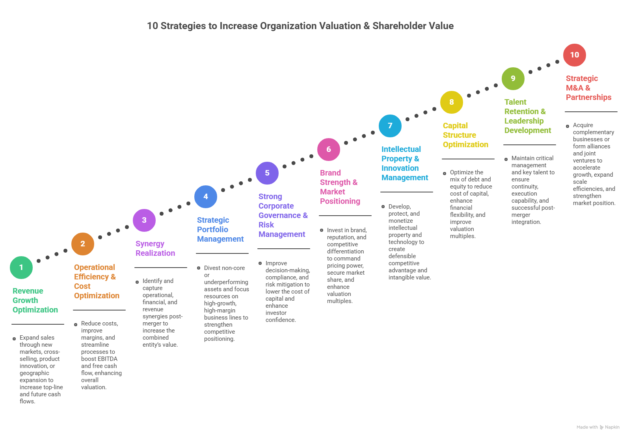
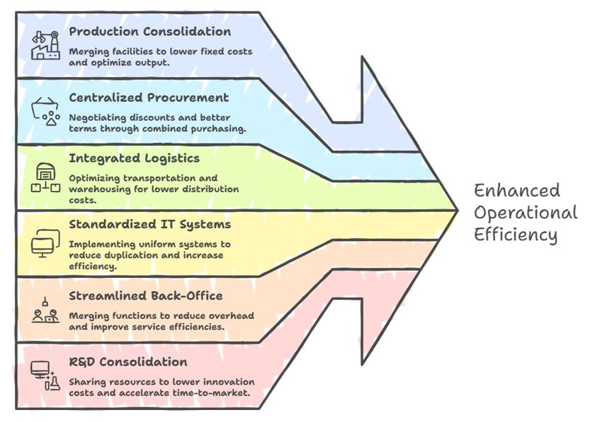
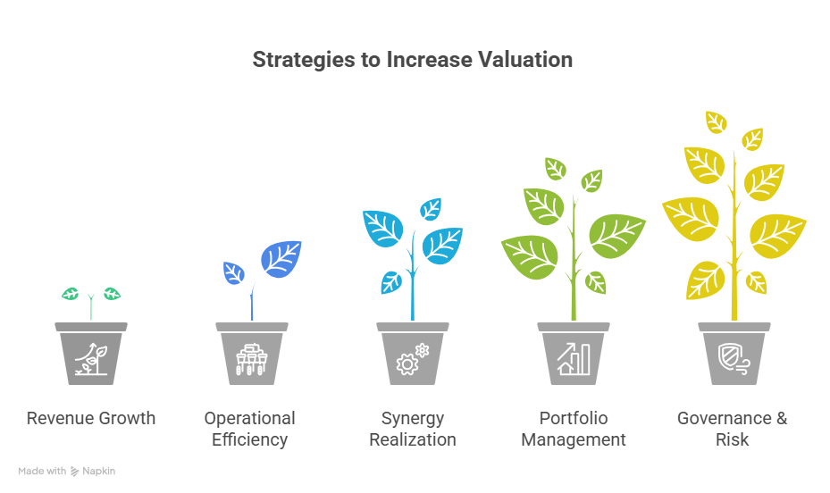
ORIGINAL DECK · VISUAL REFERENCE
How value grows
Value levers
Value roadmap
Scale pathways
Reused from the supplied original PPT; interpret using the updated v2.0 concepts and evidence.
Strategic Mergers and Acquisitions · TGS-2026061581
© 2026 Tertiary Infotech Academy Pte Ltd
66

Slide 68
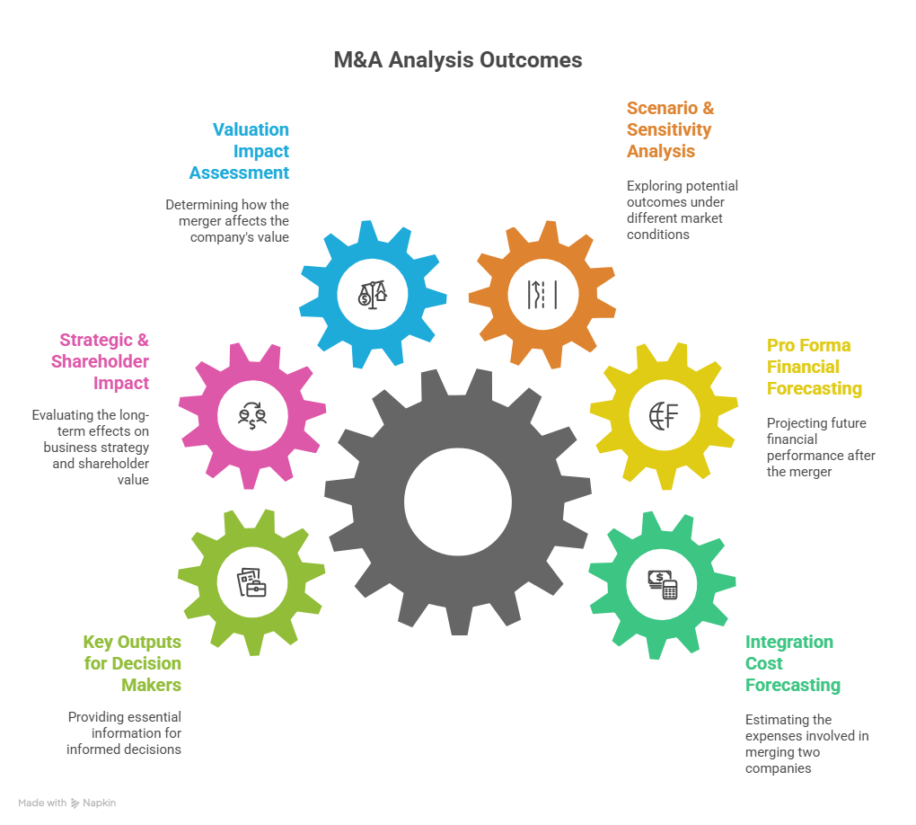
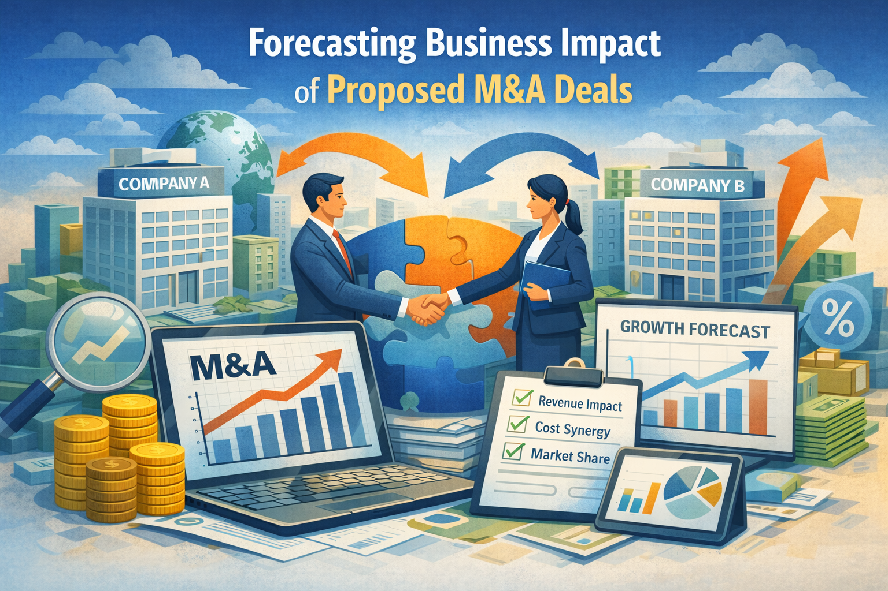
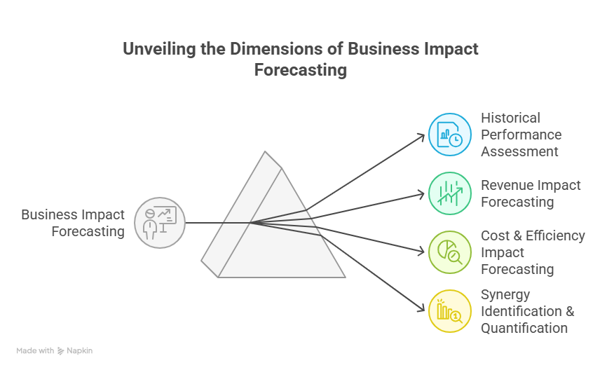
ORIGINAL DECK · VISUAL REFERENCE
How forecasts connect
Business-impact forecast
Forecast dimensions
Integrated analysis
Reused from the supplied original PPT; interpret using the updated v2.0 concepts and evidence.
Strategic Mergers and Acquisitions · TGS-2026061581
© 2026 Tertiary Infotech Academy Pte Ltd
67

Slide 69
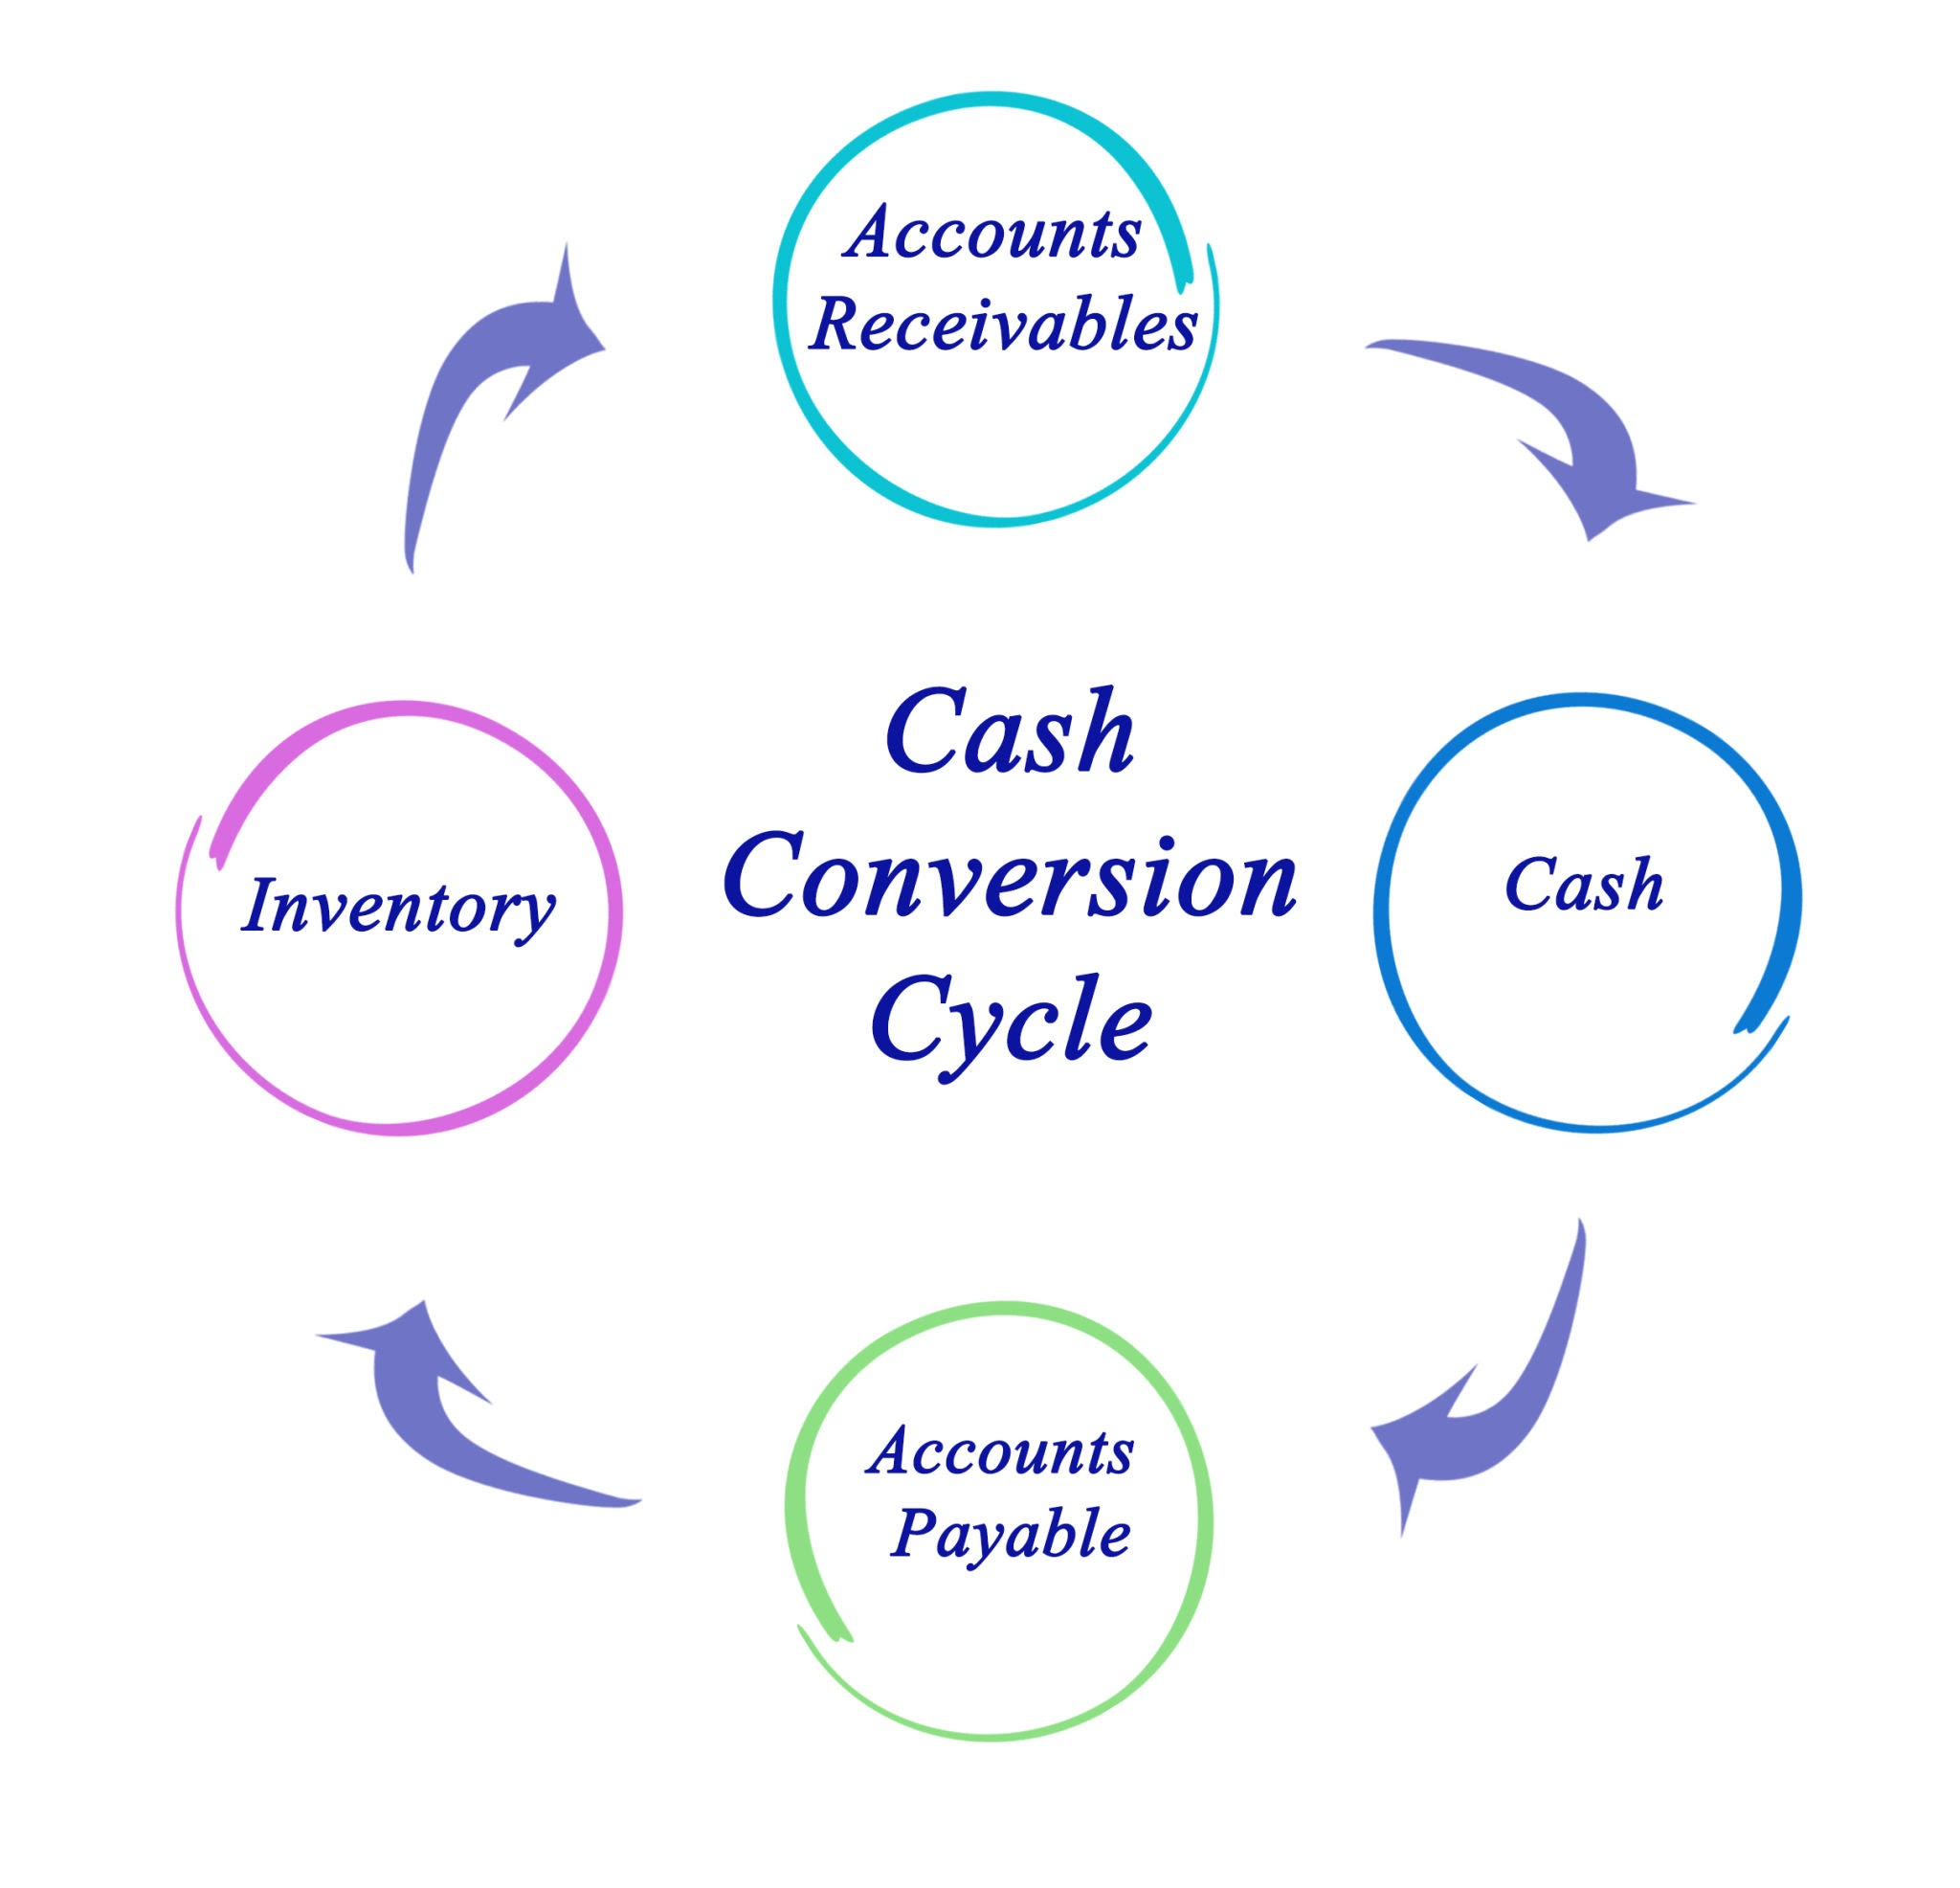
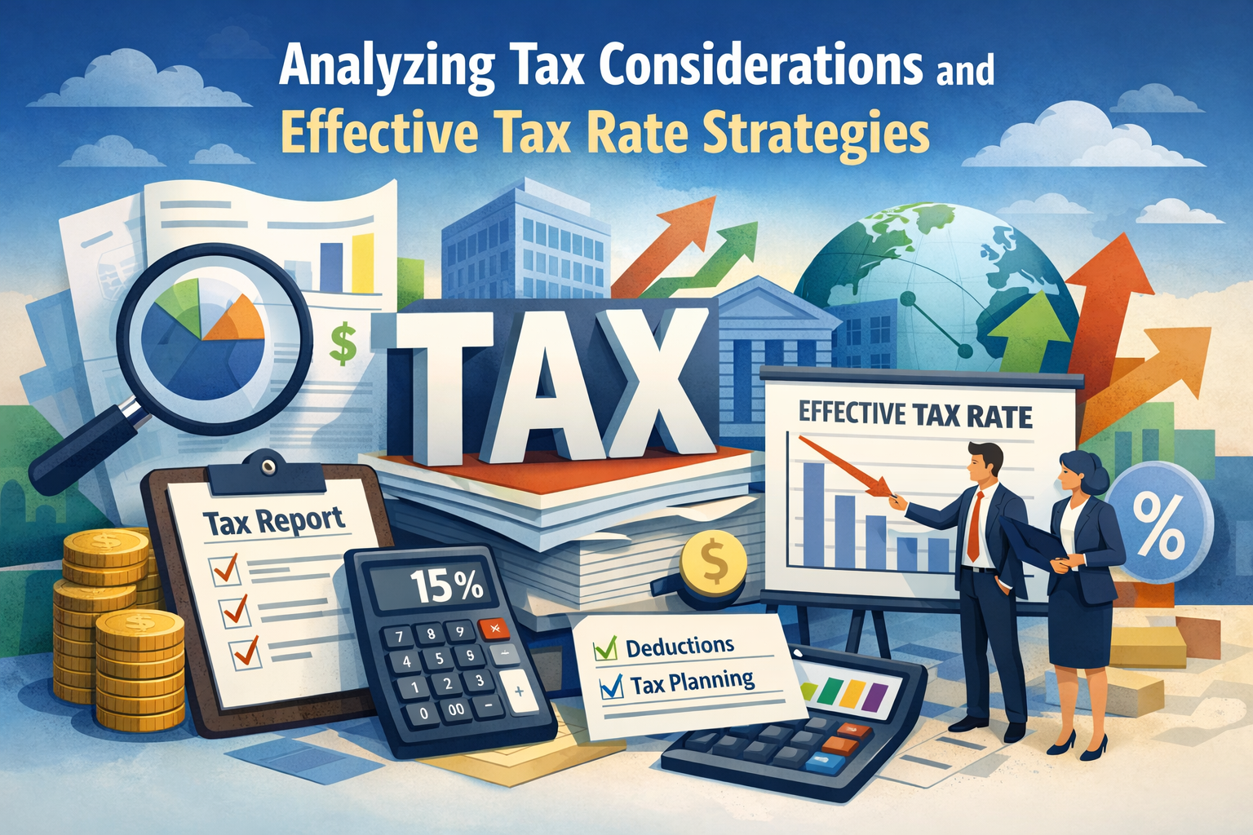
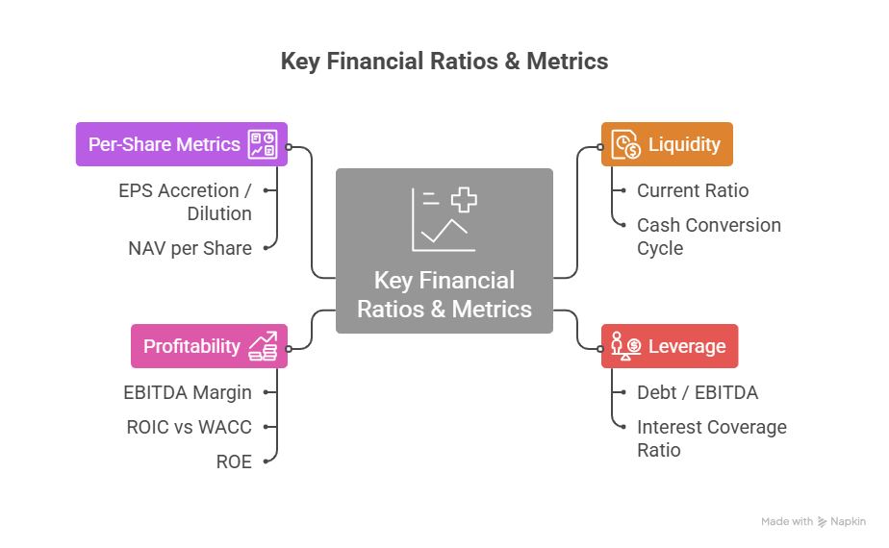
ORIGINAL DECK · VISUAL REFERENCE
How finance is challenged
Tax considerations
Financial ratios
Cash conversion cycle
Reused from the supplied original PPT; interpret using the updated v2.0 concepts and evidence.
Strategic Mergers and Acquisitions · TGS-2026061581
© 2026 Tertiary Infotech Academy Pte Ltd
68

Slide 70
REAL-WORLD CASE
Applied Activities — Forecasting, Financial and Tax Implications
Activity 3
Activity 4
Progressive case
• Bonadio–TGA Three-Year Synergy Forecast Activity
• K2 · A1 · A2 · A5
• Bonadio–TGA Pro Forma and Tax Challenge Activity
• K5 · A1 · A2
• Bonadio–TGA announced transaction
• Facts separated from course assumptions
Strategic Mergers and Acquisitions · TGS-2026061581
© 2026 Tertiary Infotech Academy Pte Ltd
69

Slide 71
TOPIC 02 · K2 · A1 · A2 · A5
Bonadio–TGA Three-Year Synergy Forecast Activity
ACTIVITY 3
Translate the public strategic rationale into a three-year base/downside/upside forecast with a traceable synergy bridge.
You'll build
A standalone-to-combined forecast, synergy register, cost-to-achieve schedule and executive dashboard
Tools / evidence: Driver model · synergy bridge · scenarios · NPV/ROIC · BI dashboard
Strategic Mergers and Acquisitions · TGS-2026061581
© 2026 Tertiary Infotech Academy Pte Ltd
70

Slide 72
ACTIVITY 3 · REAL TRANSACTION
Case Scenario — Reported Facts and Guardrails
Reported / sourced
Training assumptions / limits
• On 6 August 2026, CPA Practice Advisor reported that The Bonadio Group would add T. Gschwender & Associates (TGA), a Syracuse provider of credit-risk management services to financial institutions. The transaction was expected to close on 16 August 2026; financial terms were not disclosed. TGA was to join Bonadio's internal audit business unit within Advisory & Consulting.
• Source: https://www.cpapracticeadvisor.com/2026/08/06/credit-risk-management-firm-joins-the-bonadio-group/188098/
• Use Activity 2's course-only financial base; none of the financial inputs are reported transaction facts.
• Potential value levers may include cross-selling credit-risk, loan-review and regulatory-advisory services across Bonadio's financial-institution clients.
• Model base synergies: revenue US$0.25m/0.60m/1.00m; cost US$0.10m/0.25m/0.35m in Years 1–3.
Strategic Mergers and Acquisitions · TGS-2026061581
© 2026 Tertiary Infotech Academy Pte Ltd
71

Slide 73
ACTIVITY 3 · DISCUSS AND DECIDE
Activity Questions
Which synergy levers are buyer-specific and incremental to standalone performance?
What is the Year 3 run-rate synergy and cumulative cash realisation?
1
2
How do downside assumptions affect NPV, ROIC and payback?
Which leading indicators should the IMO monitor before financial benefits appear?
3
4
Strategic Mergers and Acquisitions · TGS-2026061581
© 2026 Tertiary Infotech Academy Pte Ltd
72

Slide 74
ACTIVITY 3 · ACCEPTANCE TEST
Bonadio–TGA Three-Year Synergy Forecast Activity
✅ Test it
Standalone and synergy cases are separate; every synergy has an owner and timing; cash impact includes cost-to-achieve and tax; downside results are visible.
Strategic Mergers and Acquisitions · TGS-2026061581
© 2026 Tertiary Infotech Academy Pte Ltd
73

Slide 75
TOPIC 02 · K5 · A1 · A2
Bonadio–TGA Pro Forma and Tax Challenge Activity
ACTIVITY 4
Trace an illustrative acquisition through the income statement, balance sheet and cash flow, then challenge tax and control assumptions.
You'll build
A pro forma bridge, purchase-price allocation sketch, tax issue list and board challenge paper
Tools / evidence: Pro forma statements · PPA · goodwill · leverage · tax diligence · approval gate
Strategic Mergers and Acquisitions · TGS-2026061581
© 2026 Tertiary Infotech Academy Pte Ltd
74

Slide 76
ACTIVITY 4 · REAL TRANSACTION
Case Scenario — Reported Facts and Guardrails
Reported / sourced
Training assumptions / limits
• On 6 August 2026, CPA Practice Advisor reported that The Bonadio Group would add T. Gschwender & Associates (TGA), a Syracuse provider of credit-risk management services to financial institutions. The transaction was expected to close on 16 August 2026; financial terms were not disclosed. TGA was to join Bonadio's internal audit business unit within Advisory & Consulting.
• Source: https://www.cpapracticeadvisor.com/2026/08/06/credit-risk-management-firm-joins-the-bonadio-group/188098/
• Training case only: purchase enterprise value US$16.0m; consideration 60% cash/debt and 40% buyer equity.
• Illustrative identifiable intangible assets: client relationships US$4.0m and trade name US$1.0m; assumed useful lives 8 and 5 years.
• Illustrative fair-value adjustment to other net assets: US$1.5m; deferred-tax rate 24%.
Strategic Mergers and Acquisitions · TGS-2026061581
© 2026 Tertiary Infotech Academy Pte Ltd
75

Slide 77
ACTIVITY 4 · DISCUSS AND DECIDE
Activity Questions
What drives goodwill under the training PPA?
How do financing, intangible amortisation and integration charges affect earnings and cash differently?
1
2
Which tax attributes or exposures need documentary evidence?
What approval conditions should the independent review team impose?
3
4
Strategic Mergers and Acquisitions · TGS-2026061581
© 2026 Tertiary Infotech Academy Pte Ltd
76

Slide 78
ACTIVITY 4 · ACCEPTANCE TEST
Bonadio–TGA Pro Forma and Tax Challenge Activity
✅ Test it
The pack ties across sources/uses and statement bridges, labels training assumptions, distinguishes cash/non-cash and recurring/one-off items, and lists unresolved tax evidence.
Strategic Mergers and Acquisitions · TGS-2026061581
© 2026 Tertiary Infotech Academy Pte Ltd
77

Slide 79
TOPIC RECAP
Recap — Forecasting, Financial and Tax Implications
Bonadio–TGA Three-Year Synergy Forecast Activity
Forecast business impact and assess effects on financial performance (K2, A1, A2, A5)
Bonadio–TGA Pro Forma and Tax Challenge Activity
Evaluate financial and tax implications and act as checks and balances (K5, A1, A2)
1
2
Decision habit
Separate facts, assumptions and unresolved evidence.
Transfer
Carry valuation and diligence commitments into integration ownership.
3
4
Strategic Mergers and Acquisitions · TGS-2026061581
© 2026 Tertiary Infotech Academy Pte Ltd
78

Slide 80
End of Day 1
Return tomorrow ready to challenge the deal

Slide 81
03
TOPIC 03 · K4 · A4 · A5 · A6
Target Identification, Risk and Intelligence
Industry intelligence · screening · diligence · risk · BI
Strategic Mergers and Acquisitions · TGS-2026061581
© 2026 Tertiary Infotech Academy Pte Ltd
80

Slide 82
TSC WST-CFI-5003-1.1-1
Key Concepts — Target Identification, Risk and Intelligence
Thesis-led search
Define the capability gap and target archetype before scanning names.
Evidence hierarchy
Triangulate management data with external, operational and customer evidence.
1
2
Holistic risk
Financial, operational, strategic, regulatory, cultural and external risks interact.
Decision intelligence
Dashboards support judgement; they do not replace accountable approval.
3
4
Strategic Mergers and Acquisitions · TGS-2026061581
© 2026 Tertiary Infotech Academy Pte Ltd
81

Slide 83
TOPIC 03 · K4 · A4 · A5 · A6
Target-screening funnel
1
2
3
4
5
▶
▶
▶
▶
Market map
Long list
Screening score
Short list
Approach and diligence
Strategic Mergers and Acquisitions · TGS-2026061581
© 2026 Tertiary Infotech Academy Pte Ltd
82

Slide 84
TOPIC 03 · K4 · A4 · A5 · A6
Industry intelligence
Market
Growth, concentration, customer demand and disruption.
Competition
Differentiation, entry barriers, pricing pressure and substitutes.
1
2
Capability
Talent, patents, licences, data, technology and delivery model.
Context
Tax, regulation, geopolitics, ESG and funding conditions.
3
4
Strategic Mergers and Acquisitions · TGS-2026061581
© 2026 Tertiary Infotech Academy Pte Ltd
83

Slide 85
TOPIC 03 · K4 · A4 · A5 · A6
Screening criteria
Strategic fit
Does the target directly advance the deal thesis?
Financial quality
Growth, margin, cash conversion and recurring revenue.
1
2
Synergy fit
Specific buyer advantages without double counting.
Executability
Valuation, owner intent, approvals and integration capacity.
3
4
Strategic Mergers and Acquisitions · TGS-2026061581
© 2026 Tertiary Infotech Academy Pte Ltd
84

Slide 86
TOPIC 03 · K4 · A4 · A5 · A6
Patents and intellectual property
Perspective A
Perspective B
• Confirm ownership, registrations, licences and freedom to operate.
• Identify open-source, contractor and employee-created IP exposure.
• Assess remaining life, enforceability and revenue dependence.
• Map IP to products, customers and the deal thesis.
• Evaluate obsolescence and substitute technologies.
• Reflect remediation, protection cost and uncertainty in price or terms.
Strategic Mergers and Acquisitions · TGS-2026061581
© 2026 Tertiary Infotech Academy Pte Ltd
85

Slide 87
TOPIC 03 · K4 · A4 · A5 · A6
Due diligence workstreams
1
2
3
4
5
▶
▶
▶
▶
Commercial and strategic
Financial and tax
Legal and regulatory
Operations and technology
People, culture and ESG
Strategic Mergers and Acquisitions · TGS-2026061581
© 2026 Tertiary Infotech Academy Pte Ltd
86

Slide 88
TOPIC 03 · K4 · A4 · A5 · A6
Quality of earnings
Revenue
Recognition, cut-off, concentration, backlog and churn.
Costs
Run-rate staffing, related parties, capitalisation and one-offs.
1
2
Working capital
Seasonality, ageing, provisions and normal level.
Cash
Conversion, capex, debt-like items and off-balance-sheet obligations.
3
4
Strategic Mergers and Acquisitions · TGS-2026061581
© 2026 Tertiary Infotech Academy Pte Ltd
87

Slide 89
TOPIC 03 · K4 · A4 · A5 · A6
MDPI review: four connected risk themes
Information asymmetry
Unequal or opaque information can distort price and decisions.
Performance and reputation
Operating outcomes and stakeholder trust influence each other.
1
2
Litigation and investor protection
Rights, enforcement and governance affect downside.
Geopolitical factors
Policy, sanctions and uncertainty can change feasibility and value.
3
4
Strategic Mergers and Acquisitions · TGS-2026061581
© 2026 Tertiary Infotech Academy Pte Ltd
88

Slide 90
TOPIC 03 · K4 · A4 · A5 · A6
Enterprise M&A risk classes
Financial
Overpayment, leverage, liquidity and forecast error.
Operational
Process, systems, service continuity and supply chain.
1
2
Strategic
Weak rationale, competition, customer response and disruption.
Regulatory and cultural
Approvals, compliance, leadership, talent and behaviour.
3
4
Strategic Mergers and Acquisitions · TGS-2026061581
© 2026 Tertiary Infotech Academy Pte Ltd
89

Slide 91
TOPIC 03 · K4 · A4 · A5 · A6
Risk identification and prioritisation
Perspective A
Perspective B
• Fishbone analysis prompts causes across people, process, technology, data, market and governance.
• Diligence findings should describe cause, event and consequence.
• Link every material risk to valuation or integration.
• Score likelihood and impact with defined scales.
• Use weighted multi-criteria methods only when assumptions are transparent.
• Prioritise by exposure, velocity, detectability and control strength.
Strategic Mergers and Acquisitions · TGS-2026061581
© 2026 Tertiary Infotech Academy Pte Ltd
90

Slide 92
TOPIC 03 · K4 · A4 · A5 · A6
Risk response
1
2
3
4
5
▶
▶
▶
▶
Avoid
Reduce
Transfer or allocate
Accept with appetite
Monitor and escalate
Strategic Mergers and Acquisitions · TGS-2026061581
© 2026 Tertiary Infotech Academy Pte Ltd
91

Slide 93
TOPIC 03 · K4 · A4 · A5 · A6
Diligence red flags
Earnings
Late adjustments, unexplained margins or unsupported add-backs.
Concentration
Dependence on a client, partner, employee, licence or platform.
1
2
Control
Weak approvals, data lineage, cybersecurity or regulatory evidence.
Culture
Leadership gaps, regretted attrition, grievance patterns or conflicting incentives.
3
4
Strategic Mergers and Acquisitions · TGS-2026061581
© 2026 Tertiary Infotech Academy Pte Ltd
92

Slide 94
TOPIC 03 · K4 · A4 · A5 · A6
Business intelligence for deal analysis
Market view
Peer multiples, pricing, market share and customer sentiment.
Target view
Cohorts, margin bridges, pipeline, churn and productivity.
1
2
Risk view
Exceptions, incidents, litigation, cyber and compliance indicators.
Integration view
Synergy, milestones, talent, clients and Day One readiness.
3
4
Strategic Mergers and Acquisitions · TGS-2026061581
© 2026 Tertiary Infotech Academy Pte Ltd
93

Slide 95
TOPIC 03 · K4 · A4 · A5 · A6
Decision gates
1
2
3
4
5
▶
▶
▶
▶
Thesis gate
Indicative value gate
Diligence gate
Signing gate
Close and Day One gate
Strategic Mergers and Acquisitions · TGS-2026061581
© 2026 Tertiary Infotech Academy Pte Ltd
94

Slide 96
TOPIC 03 · K4 · A4 · A5 · A6
Uncertainty should change price, terms, protection or the decision—not disappear in a footnote.
A strong deal team makes uncertainty visible early enough to act.
Strategic Mergers and Acquisitions · TGS-2026061581
© 2026 Tertiary Infotech Academy Pte Ltd
95

Slide 97
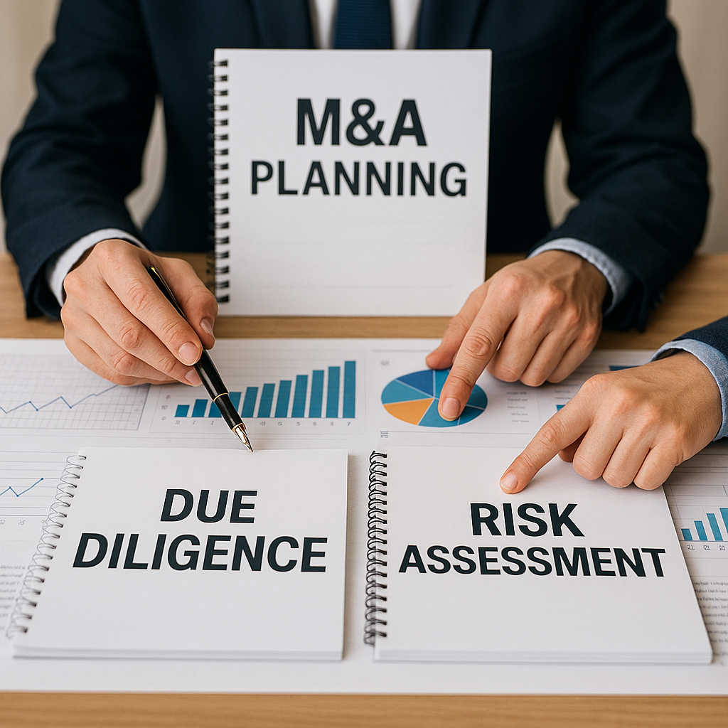
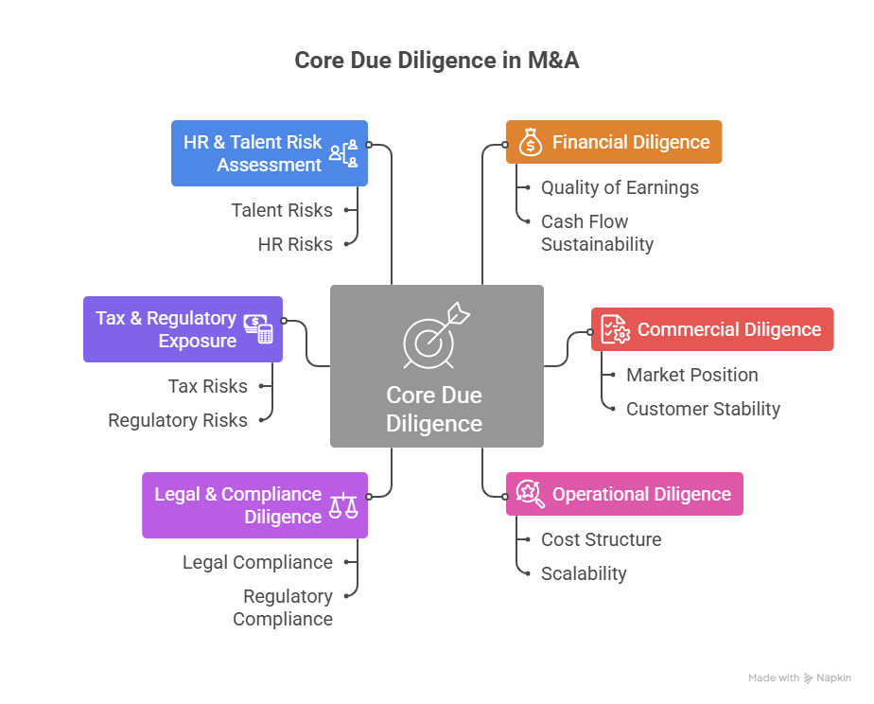
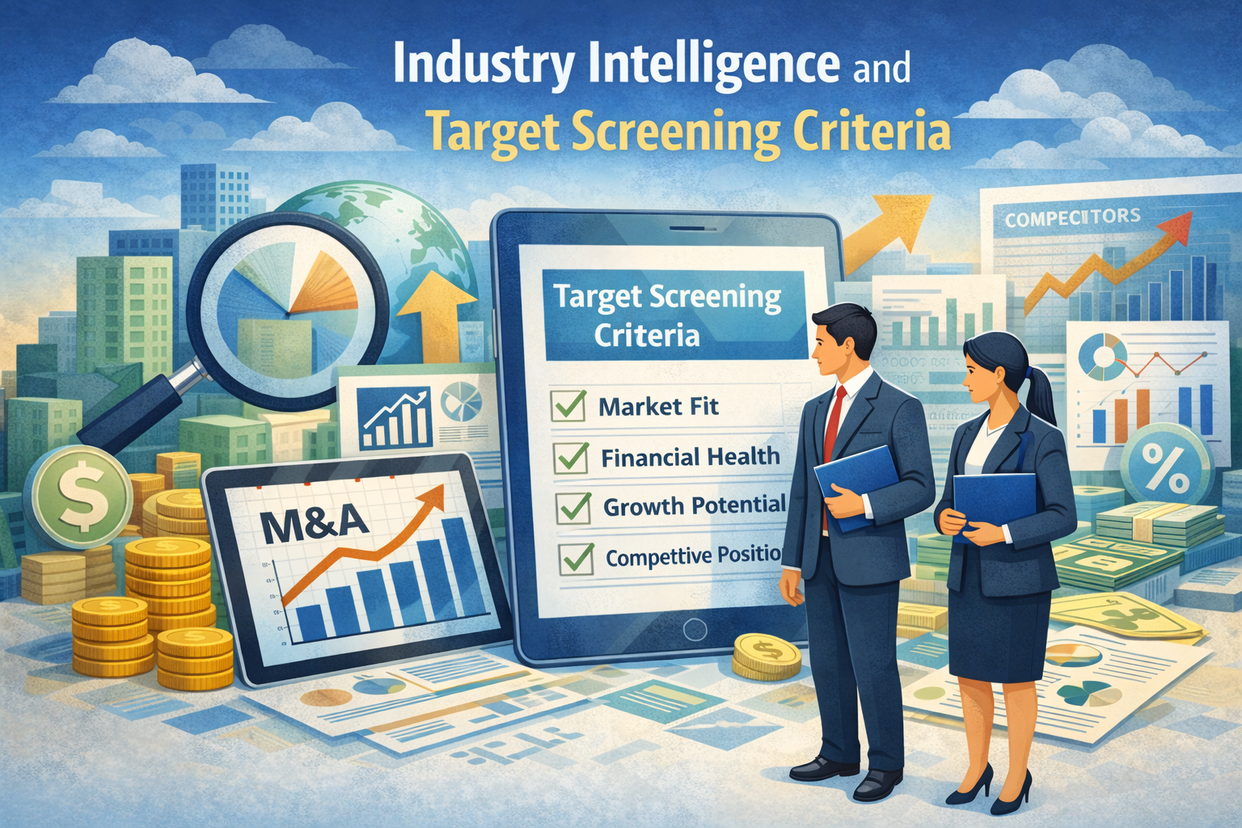
ORIGINAL DECK · VISUAL REFERENCE
How targets are screened
Target screening
Due diligence
Diligence workstreams
Reused from the supplied original PPT; interpret using the updated v2.0 concepts and evidence.
Strategic Mergers and Acquisitions · TGS-2026061581
© 2026 Tertiary Infotech Academy Pte Ltd
96

Slide 98
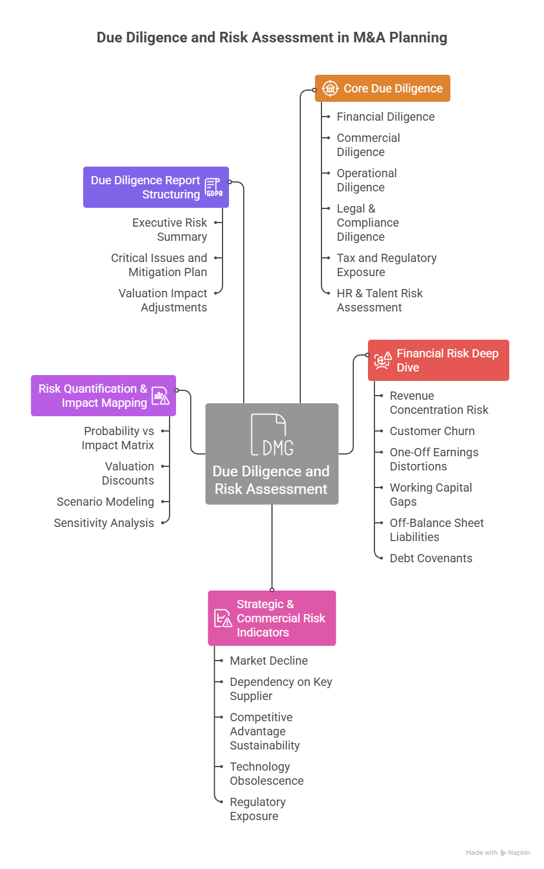
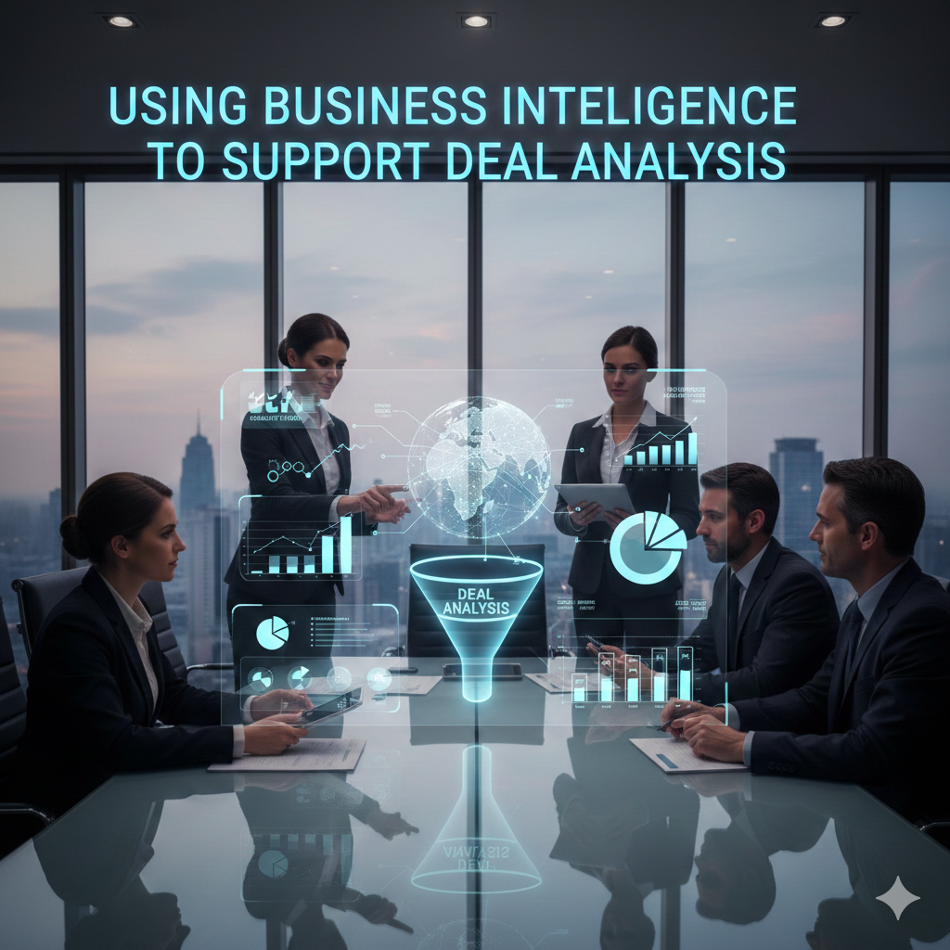
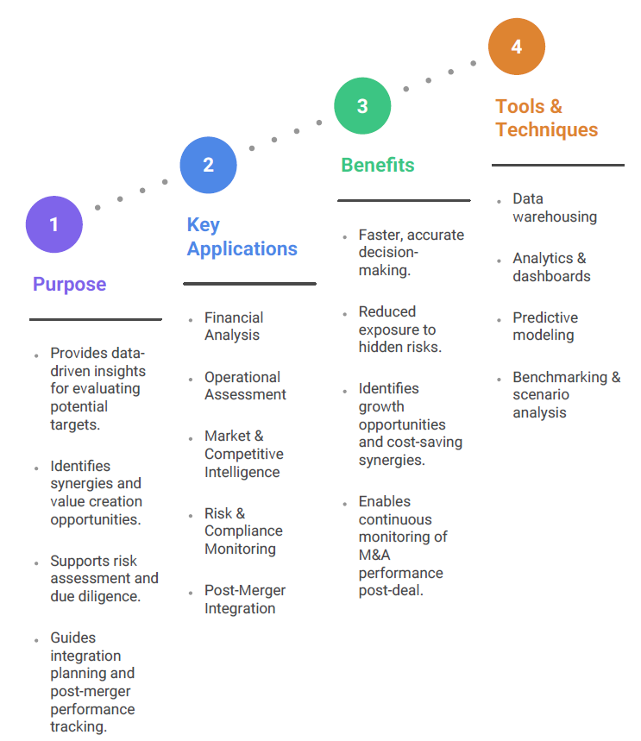
ORIGINAL DECK · VISUAL REFERENCE
How risk becomes evidence
Risk map
Business intelligence
Intelligence flow
Reused from the supplied original PPT; interpret using the updated v2.0 concepts and evidence.
Strategic Mergers and Acquisitions · TGS-2026061581
© 2026 Tertiary Infotech Academy Pte Ltd
97

Slide 99

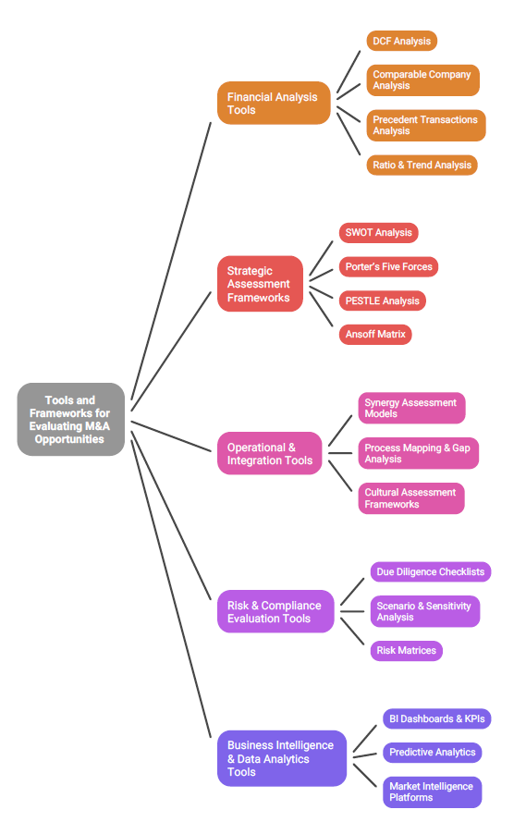
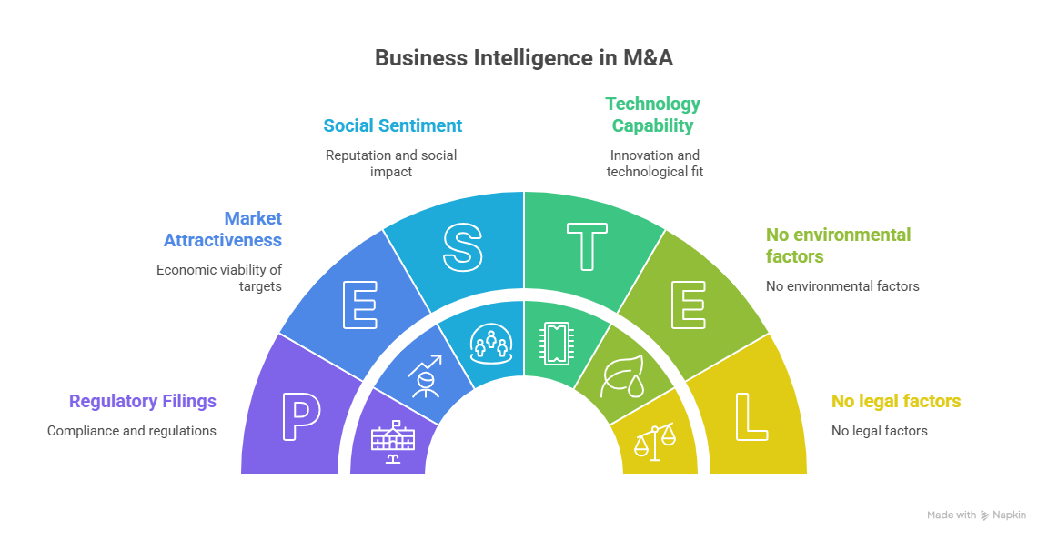
ORIGINAL DECK · VISUAL REFERENCE
How the decision is framed
PESTLE lens
Evaluation toolkit
Evaluation tree
Reused from the supplied original PPT; interpret using the updated v2.0 concepts and evidence.
Strategic Mergers and Acquisitions · TGS-2026061581
© 2026 Tertiary Infotech Academy Pte Ltd
98

Slide 100
REAL-WORLD CASE
Applied Activities — Target Identification, Risk and Intelligence
Activity 5
Activity 6
Progressive case
• Bonadio–TGA Target Screening and Diligence Activity
• K4 · A4 · A6
• Bonadio–TGA M&A Risk Intelligence Activity
• A2 · A4 · A5 · A6
• Bonadio–TGA announced transaction
• Facts separated from course assumptions
Strategic Mergers and Acquisitions · TGS-2026061581
© 2026 Tertiary Infotech Academy Pte Ltd
99

Slide 101
TOPIC 03 · K4 · A4 · A6
Bonadio–TGA Target Screening and Diligence Activity
ACTIVITY 5
Convert the public transaction rationale into a target-screening scorecard and a diligence plan that tests specialist capability, client trust and regulatory quality.
You'll build
A target-screening scorecard, evidence request list and diligence workplan
Tools / evidence: Market map · screening criteria · evidence hierarchy · QoE · commercial/legal/tech/people diligence
Strategic Mergers and Acquisitions · TGS-2026061581
© 2026 Tertiary Infotech Academy Pte Ltd
100

Slide 102
ACTIVITY 5 · REAL TRANSACTION
Case Scenario — Reported Facts and Guardrails
Reported / sourced
Training assumptions / limits
• On 6 August 2026, CPA Practice Advisor reported that The Bonadio Group would add T. Gschwender & Associates (TGA), a Syracuse provider of credit-risk management services to financial institutions. The transaction was expected to close on 16 August 2026; financial terms were not disclosed. TGA was to join Bonadio's internal audit business unit within Advisory & Consulting.
• Source: https://www.cpapracticeadvisor.com/2026/08/06/credit-risk-management-firm-joins-the-bonadio-group/188098/
• Verified facts include TGA's reported service areas, founding year, target client type and planned Bonadio business-unit placement.
• Client concentration, financial performance, staff roster, contracts, cyber posture and regulatory findings are unknown and must be requested.
• The exercise tests whether the announced rationale is supported; it does not assert undisclosed findings.
Strategic Mergers and Acquisitions · TGS-2026061581
© 2026 Tertiary Infotech Academy Pte Ltd
101

Slide 103
ACTIVITY 5 · DISCUSS AND DECIDE
Activity Questions
Which screening criteria best test the announced capability-expansion thesis?
What evidence would confirm service quality and sticky client relationships?
1
2
Which diligence items can change value, structure or the decision?
What must be handed from diligence to the integration team?
3
4
Strategic Mergers and Acquisitions · TGS-2026061581
© 2026 Tertiary Infotech Academy Pte Ltd
102

Slide 104
ACTIVITY 5 · ACCEPTANCE TEST
Bonadio–TGA Target Screening and Diligence Activity
✅ Test it
Weights total 100%, scores cite evidence status, every high-risk item has an owner and decision impact, and diligence findings flow into integration actions.
Strategic Mergers and Acquisitions · TGS-2026061581
© 2026 Tertiary Infotech Academy Pte Ltd
103

Slide 105
TOPIC 03 · A2 · A4 · A5 · A6
Bonadio–TGA M&A Risk Intelligence Activity
ACTIVITY 6
Apply the MDPI risk themes and the SSRN enterprise-risk framework to the real announced deal, then create a decision dashboard and escalation memo.
You'll build
A risk taxonomy, heat map, bow-tie controls, BI dashboard and go/conditional/no-go memo
Tools / evidence: MDPI risk themes · Fishbone · risk scoring · controls · leading indicators · decision gates
Strategic Mergers and Acquisitions · TGS-2026061581
© 2026 Tertiary Infotech Academy Pte Ltd
104

Slide 106
ACTIVITY 6 · REAL TRANSACTION
Case Scenario — Reported Facts and Guardrails
Reported / sourced
Training assumptions / limits
• On 6 August 2026, CPA Practice Advisor reported that The Bonadio Group would add T. Gschwender & Associates (TGA), a Syracuse provider of credit-risk management services to financial institutions. The transaction was expected to close on 16 August 2026; financial terms were not disclosed. TGA was to join Bonadio's internal audit business unit within Advisory & Consulting.
• Source: https://www.mdpi.com/2227-9091/12/9/143
• The MDPI review identifies four connected themes: information asymmetry; performance/reputation; litigation/investor protection; geopolitical factors.
• The SSRN review discusses financial, operational, strategic, regulatory and cultural risk and structured identification/quantification methods.
• Risks used in this case are hypotheses for diligence, not allegations about either firm.
Strategic Mergers and Acquisitions · TGS-2026061581
© 2026 Tertiary Infotech Academy Pte Ltd
105

Slide 107
ACTIVITY 6 · DISCUSS AND DECIDE
Activity Questions
How do information asymmetry and reputation risk interact in a regulated advisory business?
Which causes sit behind client loss, specialist-talent loss and regulatory-quality failure?
1
2
What controls reduce likelihood and what recovery actions reduce impact?
Which metrics and thresholds should trigger escalation?
3
4
Strategic Mergers and Acquisitions · TGS-2026061581
© 2026 Tertiary Infotech Academy Pte Ltd
106

Slide 108
ACTIVITY 6 · ACCEPTANCE TEST
Bonadio–TGA M&A Risk Intelligence Activity
✅ Test it
Risk statements are specific, scoring scales are defined, controls have owners, dashboard thresholds are actionable and the recommendation follows the evidence.
Strategic Mergers and Acquisitions · TGS-2026061581
© 2026 Tertiary Infotech Academy Pte Ltd
107

Slide 109
TOPIC RECAP
Recap — Target Identification, Risk and Intelligence
Bonadio–TGA Target Screening and Diligence Activity
Use industry intelligence to screen a target and plan risk-based diligence (K4, A4, A6)
Bonadio–TGA M&A Risk Intelligence Activity
Use BI to assess and manage M&A risk across the lifecycle (A2, A4, A5, A6)
1
2
Decision habit
Separate facts, assumptions and unresolved evidence.
Transfer
Carry valuation and diligence commitments into integration ownership.
3
4
Strategic Mergers and Acquisitions · TGS-2026061581
© 2026 Tertiary Infotech Academy Pte Ltd
108

Slide 110
Lunch Break
60 minutes

Slide 111
04
TOPIC 04 · A2 · A3 · K2
Stakeholder Alignment and Post-Merger Integration
Governance · checks and balances · IMO · culture · change
Strategic Mergers and Acquisitions · TGS-2026061581
© 2026 Tertiary Infotech Academy Pte Ltd
110

Slide 112
TSC WST-CFI-5003-1.1-1
Key Concepts — Stakeholder Alignment and Post-Merger Integration
Integration starts before close
Diligence findings and the deal thesis must transfer into the plan.
Governance enables pace
Decision rights, escalation and cadence prevent cross-functional drift.
1
2
Protect value
Client continuity, talent and culture are economic value drivers.
Measure outcomes
Track commitments, not activity volume.
3
4
Strategic Mergers and Acquisitions · TGS-2026061581
© 2026 Tertiary Infotech Academy Pte Ltd
111

Slide 113
TOPIC 04 · A2 · A3 · K2
Stakeholder map
Governance
Board, SteerCo, deal executive and regulators.
Delivery
IMO, workstream leads, integration teams and business owners.
1
2
People
Leaders, employees, talent groups and representatives.
External
Clients, suppliers, lenders, partners and communities.
3
4
Strategic Mergers and Acquisitions · TGS-2026061581
© 2026 Tertiary Infotech Academy Pte Ltd
112

Slide 114
TOPIC 04 · A2 · A3 · K2
RACI and decision rights
Perspective A
Perspective B
• Responsible performs the work; Accountable owns the outcome.
• Consulted contributes before a decision; Informed receives the result.
• One accountable owner avoids committee ambiguity.
• Define reserved decisions, thresholds and escalation routes.
• Separate deal sponsorship from independent control challenge.
• Record decisions, assumptions, owners and due dates.
Strategic Mergers and Acquisitions · TGS-2026061581
© 2026 Tertiary Infotech Academy Pte Ltd
113

Slide 115
TOPIC 04 · A2 · A3 · K2
EY: nine integration steps
Step 1
Value drivers and principles
Step 2
Legal interaction rules
Step 3
Stand up IMO
1
2
3
Step 4
Day One charters
Step 5
Operating model
Step 6
Functional plans
4
5
6
Step 7
Execute
Step 8
Capture value
Step 9
Manage stakeholders
7
8
9
Strategic Mergers and Acquisitions · TGS-2026061581
© 2026 Tertiary Infotech Academy Pte Ltd
114

Slide 116
TOPIC 04 · A2 · A3 · K2
Three-tier integration governance
SteerCo
IMO
Functional teams
• Sets direction and resolves the highest-significance issues.
• Coordinates workstreams, risks, dependencies, decisions and value.
• Deliver milestones and resolve day-to-day issues.
Strategic Mergers and Acquisitions · TGS-2026061581
© 2026 Tertiary Infotech Academy Pte Ltd
115

Slide 117
TOPIC 04 · A2 · A3 · K2
Pre-close guardrails
Clean team
Restrict competitively sensitive data to authorised reviewers.
Gun-jumping
Do not control the target before legal close.
1
2
Confidentiality
Define channels, access, retention and permitted use.
Readiness
Plan Day One without prematurely implementing control.
3
4
Strategic Mergers and Acquisitions · TGS-2026061581
© 2026 Tertiary Infotech Academy Pte Ltd
116

Slide 118
TOPIC 04 · A2 · A3 · K2
Day One must-haves
People
Leadership, employment continuity, access and emergency contacts.
Clients
Service continuity, relationship owners and approved messages.
1
2
Controls
Authority limits, cash, compliance, cyber and incident escalation.
Operations
Systems access, critical vendors, sites and business continuity.
3
4
Strategic Mergers and Acquisitions · TGS-2026061581
© 2026 Tertiary Infotech Academy Pte Ltd
117

Slide 119
TOPIC 04 · A2 · A3 · K2
First 100 days
1
2
3
4
5
▶
▶
▶
▶
Stabilise
Confirm baseline
Mobilise initiatives
Track outcomes
Adjust and embed
Strategic Mergers and Acquisitions · TGS-2026061581
© 2026 Tertiary Infotech Academy Pte Ltd
118

Slide 120
TOPIC 04 · A2 · A3 · K2
Integration strategy choices
Absorption
Fully integrate when standardisation and scale are central to value.
Preservation
Protect autonomy when brand, culture or specialist capability drives value.
1
2
Symbiosis
Share selected capabilities while allowing mutual adaptation.
Holding
Maintain a portfolio relationship with limited operational integration.
3
4
Strategic Mergers and Acquisitions · TGS-2026061581
© 2026 Tertiary Infotech Academy Pte Ltd
119

Slide 121
TOPIC 04 · A2 · A3 · K2
Synergy governance
Baseline
Freeze the standalone reference point and avoid moving targets.
Initiative
Name the action, owner, milestone, dependency and cost-to-achieve.
1
2
Finance validation
Confirm recurring P&L and cash impact; remove double counting.
Reporting
Separate forecast, achieved, at-risk and lost value.
3
4
Strategic Mergers and Acquisitions · TGS-2026061581
© 2026 Tertiary Infotech Academy Pte Ltd
120

Slide 122
TOPIC 04 · A2 · A3 · K2
Culture integration
Perspective A
Perspective B
• Profile decision style, client model, risk appetite, incentives and leadership behaviours.
• Identify where differences are complementary and where they threaten the thesis.
• Design the future culture through observable behaviours, not slogans.
• Listen through interviews, surveys, data and leader observation.
• Protect critical identity where specialist trust creates value.
• Track regretted attrition, engagement, client continuity and conduct indicators.
Strategic Mergers and Acquisitions · TGS-2026061581
© 2026 Tertiary Infotech Academy Pte Ltd
121

Slide 123
TOPIC 04 · A2 · A3 · K2
Professional services integration
Talent
Retention combines economics, career opportunity, identity and clarity.
Clients
Relationship continuity and conflict checks protect revenue.
1
2
Governance
Partner autonomy must align with board, risk and reporting discipline.
Technology
Data, workflow and platforms should scale without weakening quality.
3
4
Strategic Mergers and Acquisitions · TGS-2026061581
© 2026 Tertiary Infotech Academy Pte Ltd
122

Slide 124
TOPIC 04 · A2 · A3 · K2
Change and communication plan
Audience
Map what each stakeholder needs to know, feel and do.
Message
Explain the rationale, impact, timing and unresolved questions honestly.
1
2
Channel
Use leader cascades, client outreach, town halls and two-way forums.
Feedback
Track sentiment, rumours, adoption barriers and response actions.
3
4
Strategic Mergers and Acquisitions · TGS-2026061581
© 2026 Tertiary Infotech Academy Pte Ltd
123

Slide 125
TOPIC 04 · A2 · A3 · K2
Integration scorecard
Value
Revenue, cost, capital and cost-to-achieve.
Customers
Retention, pipeline, complaints and service levels.
1
2
People
Critical talent retention, engagement and role fill.
Execution and risk
Milestones, dependencies, incidents and controls.
3
4
Strategic Mergers and Acquisitions · TGS-2026061581
© 2026 Tertiary Infotech Academy Pte Ltd
124

Slide 126
TOPIC 04 · A2 · A3 · K2
Closing completes the transaction; integration must still earn the value.
The deal thesis becomes an operating commitment on Day One.
Strategic Mergers and Acquisitions · TGS-2026061581
© 2026 Tertiary Infotech Academy Pte Ltd
125

Slide 127
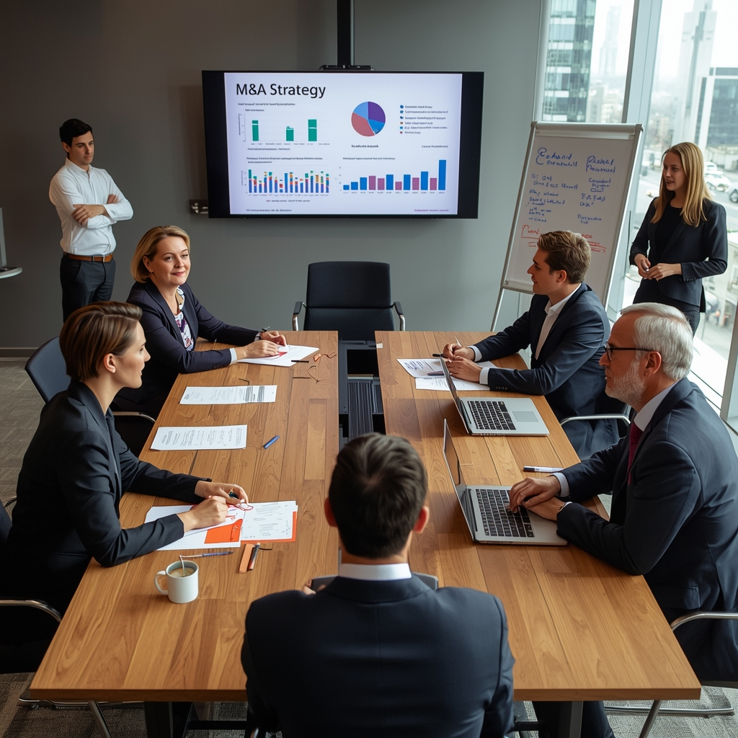


ORIGINAL DECK · VISUAL REFERENCE
How stakeholders govern
Stakeholder engagement
Checks and balances
Culture and change
Reused from the supplied original PPT; interpret using the updated v2.0 concepts and evidence.
Strategic Mergers and Acquisitions · TGS-2026061581
© 2026 Tertiary Infotech Academy Pte Ltd
126

Slide 128

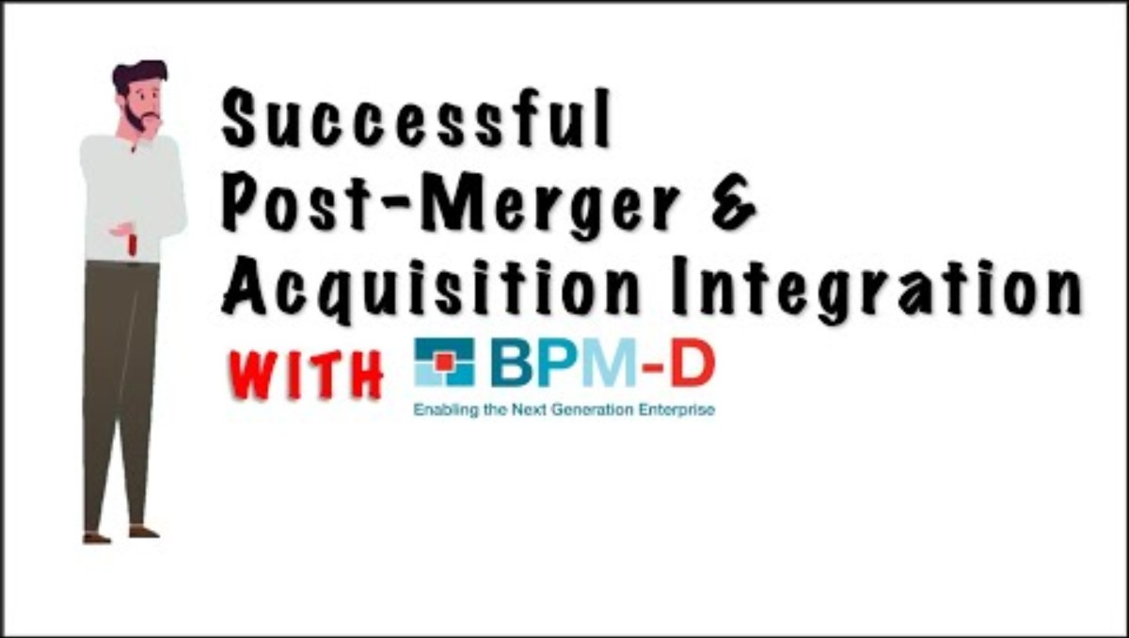
ORIGINAL DECK · VISUAL REFERENCE
How integration is mobilised
Post-merger integration
Implementation plan
Culture and change
Reused from the supplied original PPT; interpret using the updated v2.0 concepts and evidence.
Strategic Mergers and Acquisitions · TGS-2026061581
© 2026 Tertiary Infotech Academy Pte Ltd
127

Slide 129


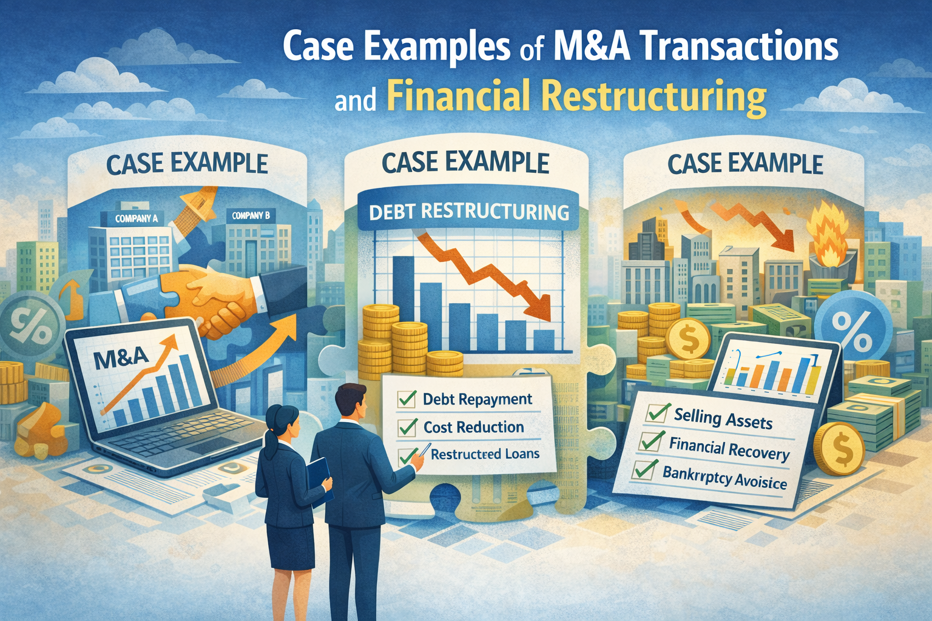
ORIGINAL DECK · VISUAL REFERENCE
How the original story connects
Valuation strategy
Scale strategy
Transaction examples
Reused from the supplied original PPT; interpret using the updated v2.0 concepts and evidence.
Strategic Mergers and Acquisitions · TGS-2026061581
© 2026 Tertiary Infotech Academy Pte Ltd
128

Slide 130
REAL-WORLD CASE
Applied Activities — Stakeholder Alignment and Post-Merger Integration
Activity 7
Activity 8
Progressive case
• Bonadio–TGA Integration Program Design Activity
• A2 · A3 · A4
• Bonadio–TGA Culture, Talent and Client Continuity Activity
• K2 · A2 · A3
• Bonadio–TGA announced transaction
• Facts separated from course assumptions
Strategic Mergers and Acquisitions · TGS-2026061581
© 2026 Tertiary Infotech Academy Pte Ltd
129

Slide 131
TOPIC 04 · A2 · A3 · A4
Bonadio–TGA Integration Program Design Activity
ACTIVITY 7
Use EY's nine-step integration framework to turn the Bonadio–TGA deal thesis and diligence findings into a Day One and first-100-days program.
You'll build
Integration strategy, governance/RACI, workstream charters, Day One checklist and 100-day roadmap
Tools / evidence: SteerCo · IMO · workstreams · legal guardrails · operating model · synergy governance
Strategic Mergers and Acquisitions · TGS-2026061581
© 2026 Tertiary Infotech Academy Pte Ltd
130

Slide 132
ACTIVITY 7 · REAL TRANSACTION
Case Scenario — Reported Facts and Guardrails
Reported / sourced
Training assumptions / limits
• On 6 August 2026, CPA Practice Advisor reported that The Bonadio Group would add T. Gschwender & Associates (TGA), a Syracuse provider of credit-risk management services to financial institutions. The transaction was expected to close on 16 August 2026; financial terms were not disclosed. TGA was to join Bonadio's internal audit business unit within Advisory & Consulting.
• Source: https://www.ey.com/content/dam/ey-unified-site/ey-com/en-gl/insights/mergers-acquisitions/documents/ey-nine-key-steps-to-setting-up-merger-acquisition-integration-program.pdf
• The exercise occurs before the expected close, so integration planning must respect confidentiality and gun-jumping restrictions.
• TGA is expected to join Bonadio's internal audit business unit; detailed operating-model decisions are not publicly reported.
• Learner choices are recommendations based on the deal thesis and risk analysis.
Strategic Mergers and Acquisitions · TGS-2026061581
© 2026 Tertiary Infotech Academy Pte Ltd
131

Slide 133
ACTIVITY 7 · DISCUSS AND DECIDE
Activity Questions
Which value drivers and guiding principles should govern integration decisions?
What belongs with SteerCo, IMO and functional workstreams?
1
2
What must be ready on Day One, and what should be phased?
How will the team prove that value is captured without weakening quality?
3
4
Strategic Mergers and Acquisitions · TGS-2026061581
© 2026 Tertiary Infotech Academy Pte Ltd
132

Slide 134
ACTIVITY 7 · ACCEPTANCE TEST
Bonadio–TGA Integration Program Design Activity
✅ Test it
The blueprint maps all nine EY steps, separates pre-close planning from post-close control, assigns governance and owners, and links integration actions to value and risk.
Strategic Mergers and Acquisitions · TGS-2026061581
© 2026 Tertiary Infotech Academy Pte Ltd
133

Slide 135
TOPIC 04 · K2 · A2 · A3
Bonadio–TGA Culture, Talent and Client Continuity Activity
ACTIVITY 8
Use the professional-services M&A briefing to design a people-and-client integration plan that preserves specialist identity while enabling scaled capabilities.
You'll build
Culture risk map, critical-talent plan, client continuity playbook and stakeholder communication pack
Tools / evidence: Culture diligence · retention · client ownership · change narrative · pulse dashboard
Strategic Mergers and Acquisitions · TGS-2026061581
© 2026 Tertiary Infotech Academy Pte Ltd
134

Slide 136
ACTIVITY 8 · REAL TRANSACTION
Case Scenario — Reported Facts and Guardrails
Reported / sourced
Training assumptions / limits
• On 6 August 2026, CPA Practice Advisor reported that The Bonadio Group would add T. Gschwender & Associates (TGA), a Syracuse provider of credit-risk management services to financial institutions. The transaction was expected to close on 16 August 2026; financial terms were not disclosed. TGA was to join Bonadio's internal audit business unit within Advisory & Consulting.
• Source: https://www.financierworldwide.com/briefing-room-ma-in-the-professional-services-sector
• The briefing emphasises that professional-services value depends heavily on people, client relationships, specialist identity and culture.
• No talent, client or culture problems have been reported for the Bonadio–TGA transaction; the risks below are planning hypotheses.
• Retention should combine financial alignment, career opportunity, clarity and cultural fit.
Strategic Mergers and Acquisitions · TGS-2026061581
© 2026 Tertiary Infotech Academy Pte Ltd
135

Slide 137
ACTIVITY 8 · DISCUSS AND DECIDE
Activity Questions
Which aspects of TGA's specialist identity should be preserved, and which should standardise?
Who are the critical talent and client relationships, and what would make them leave?
1
2
How should leadership explain the transaction to staff and clients?
Which leading indicators show culture or client value is deteriorating?
3
4
Strategic Mergers and Acquisitions · TGS-2026061581
© 2026 Tertiary Infotech Academy Pte Ltd
136

Slide 138
ACTIVITY 8 · ACCEPTANCE TEST
Bonadio–TGA Culture, Talent and Client Continuity Activity
✅ Test it
The playbook distinguishes preservation from standardisation, names owners and indicators, covers critical talent and clients, and includes a tested response to an early warning.
Strategic Mergers and Acquisitions · TGS-2026061581
© 2026 Tertiary Infotech Academy Pte Ltd
137

Slide 139
TOPIC RECAP
Recap — Stakeholder Alignment and Post-Merger Integration
Bonadio–TGA Integration Program Design Activity
Develop an implementation plan with stakeholders and governance (A2, A3, A4)
Bonadio–TGA Culture, Talent and Client Continuity Activity
Align stakeholders and manage culture/change in professional-services integration (K2, A2, A3)
1
2
Decision habit
Separate facts, assumptions and unresolved evidence.
Transfer
Carry valuation and diligence commitments into integration ownership.
3
4
Strategic Mergers and Acquisitions · TGS-2026061581
© 2026 Tertiary Infotech Academy Pte Ltd
138

Slide 140
W
WRAP-UP
From Deal Thesis to Realised Value
Strategic Mergers and Acquisitions · TGS-2026061581
© 2026 Tertiary Infotech Academy Pte Ltd
139

Slide 141
COURSE SUMMARY
What You Achieved
LO1
Apply financial instruments and valuation methods to structure mergers and acquisitions that optimise organisational benefit and shareholder value.
LO2
Evaluate the business, financial and tax impact of potential M&A deals using industry data and forecasting techniques.
1
2
LO3
Identify, assess and manage M&A risks across the full transaction lifecycle from target selection to post-deal integration.
LO4
Collaborate with stakeholders to develop and implement M&A plans while ensuring governance, synergy realisation and strategic alignment.
3
4
Strategic Mergers and Acquisitions · TGS-2026061581
© 2026 Tertiary Infotech Academy Pte Ltd
140

Slide 142
TAKEAWAY
The complete M&A discipline
1
2
3
4
5
▶
▶
▶
▶
Thesis
Value and structure
Diligence
Risk-adjusted decision
Integration and benefits
Strategic Mergers and Acquisitions · TGS-2026061581
© 2026 Tertiary Infotech Academy Pte Ltd
141

Slide 143
COURSE ENRICHMENT
Evidence Sources
Course page
https://www.tertiarycourses.com.sg/wsq-strategic-mergers-and-acquisitions-valuation-risk-and-integration.html
Bonadio–TGA transaction report
https://www.cpapracticeadvisor.com/2026/08/06/credit-risk-management-firm-joins-the-bonadio-group/188098/
1
2
M&A risk review
https://www.mdpi.com/2227-9091/12/9/143
Professional services M&A briefing
https://www.financierworldwide.com/briefing-room-ma-in-the-professional-services-sector
3
4
Strategic Mergers and Acquisitions · TGS-2026061581
© 2026 Tertiary Infotech Academy Pte Ltd
142

Slide 144
COURSE ENRICHMENT
Evidence Sources — Continued
EY integration program
https://www.ey.com/content/dam/ey-unified-site/ey-com/en-gl/insights/mergers-acquisitions/documents/ey-nine-key-steps-to-setting-up-merger-acquisition-integration-program.pdf
Enterprise M&A risk management review
https://papers.ssrn.com/sol3/papers.cfm?abstract_id=5106493
1
2
Strategic Mergers and Acquisitions · TGS-2026061581
© 2026 Tertiary Infotech Academy Pte Ltd
143

Slide 145
LMS
Courseware and Assessment on the LMS
https://lms-tms.tertiaryinfotech.com/
Courseware
Assessment
Submission
Download the current slides and Learner Guide.
Open and complete the WA then Case Study.
Upload completed answers and complete the sign-off process.
Strategic Mergers and Acquisitions · TGS-2026061581
© 2026 Tertiary Infotech Academy Pte Ltd
144

Slide 146
FINAL ASSESSMENT
Assessment Reminder
WA-SAQ · 4:00–5:00pm
Case Study · 5:00–6:00pm
Finish
• 4 open-ended questions
• K1–K5
• Open book
• 3 integrated tasks
• A1–A6
• Open book
• Submit on LMS
• Digital attendance
• Sign summary record
Strategic Mergers and Acquisitions · TGS-2026061581
© 2026 Tertiary Infotech Academy Pte Ltd
145

Slide 147
ON ASSESSMENT DAY
Assessment Flow
1
2
3
4
5
▶
▶
▶
▶
TRAQOM / SSG attendance
Assessment digital attendance
Sit WA then Case Study
Submit answers on the LMS
Sign the Assessment Summary Record
Strategic Mergers and Acquisitions · TGS-2026061581
© 2026 Tertiary Infotech Academy Pte Ltd
146

Slide 148
TRAQOM · SSG DIGITAL ATTENDANCE
Digital Attendance (Mandatory)
Scan
Use the QR code shown by the trainer.
Submit
Complete the assessment attendance event.
1
2
Confirm
Verify the submission confirmation.
Resolve
Tell the trainer immediately if it fails.
3
4
Strategic Mergers and Acquisitions · TGS-2026061581
© 2026 Tertiary Infotech Academy Pte Ltd
147

Slide 149
STRATEGIC M&A
Thank You
Make the deal thesis testable, the risk visible and the value accountable.
Strategic Mergers and Acquisitions · TGS-2026061581
© 2026 Tertiary Infotech Academy Pte Ltd
148

